Slide 1
Incidence of immigrant apprehensions in the United States
Zaheen Choudhary| Dr.Karl Ho| Data Visualization

Slide 2
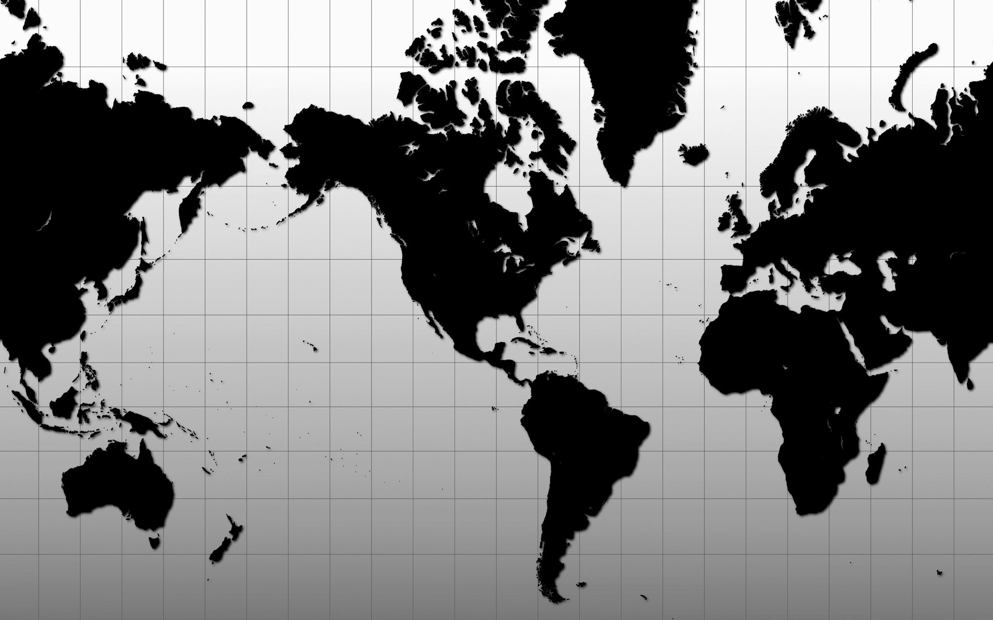
Introduction
Analyzing various factors which contribute to the incidence of immigrant apprehensions in the United States according to the country of origin by using a cross-sectional data from 96 countries averaged across the 2002–2013 period
Testing whether chronic socio-economic problems such as corruption, crimes, and poverty in the country of origin are central in explaining the cross country variations in alien apprehensions in the United States or not

Slide 3
Dependent Variable:
APR : Annual number of apprehensions per 100,000 aliens
Independent Variables:
Corruption: Corruption Level of a Country
Income: Per capita Income
Alcohol: Alcohol per capita consumption (average daily intake; grams of pure alcohol; 15+ years population)
Theft: Losses due to theft, robbery, vandalism, and arson (% sales)
Homicide: Homicide rate (per 100,000 people)
Distance: Distance from the United States to that country (in kilometers)
Education: The average total schooling years of people aged 15 and over
Unemployment: Unemployment (% of total labor force)
Tourism: The number of tourist arrivals and International tourism expenditures by international inbound visitors
Investment: The U.S. Direct Investment Abroad Position
Prostitution: The legality of prostitution laws by country
Traffic: The estimated road traffic deaths (per 100,000 people)

Slide 4
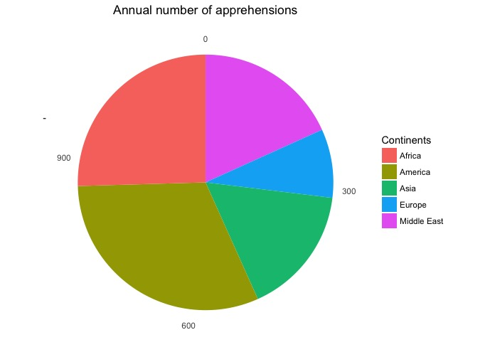
Sample 1
Analysis on the continent with the highest APR
Highest APR?
361.53
The Avg. APR in Americas is higher than in any other continent.
Pie Chart
A
B
C
17.44
AVG HOMICIDE RATE
0.61
AVG PROSTITUTION RATE
361.53
AVG APR

Slide 5

Sample 2
0.64
8.69
17.44
8.92
29.96
Theft
Education
Homicide
Unemployment
Alcohol
America’s Statistics
Diving into the probable reasons for the high apprehension rate

Slide 6
Apprehended Immigrants by country of origin in the United States
Highest APR:
Nicaragua
Costa Rica
Lowest APR:
Japan
Germany

Slide 7
Visualizing the trend for every country by plotting every independent variable against the apprehensions ratio

Slide 8
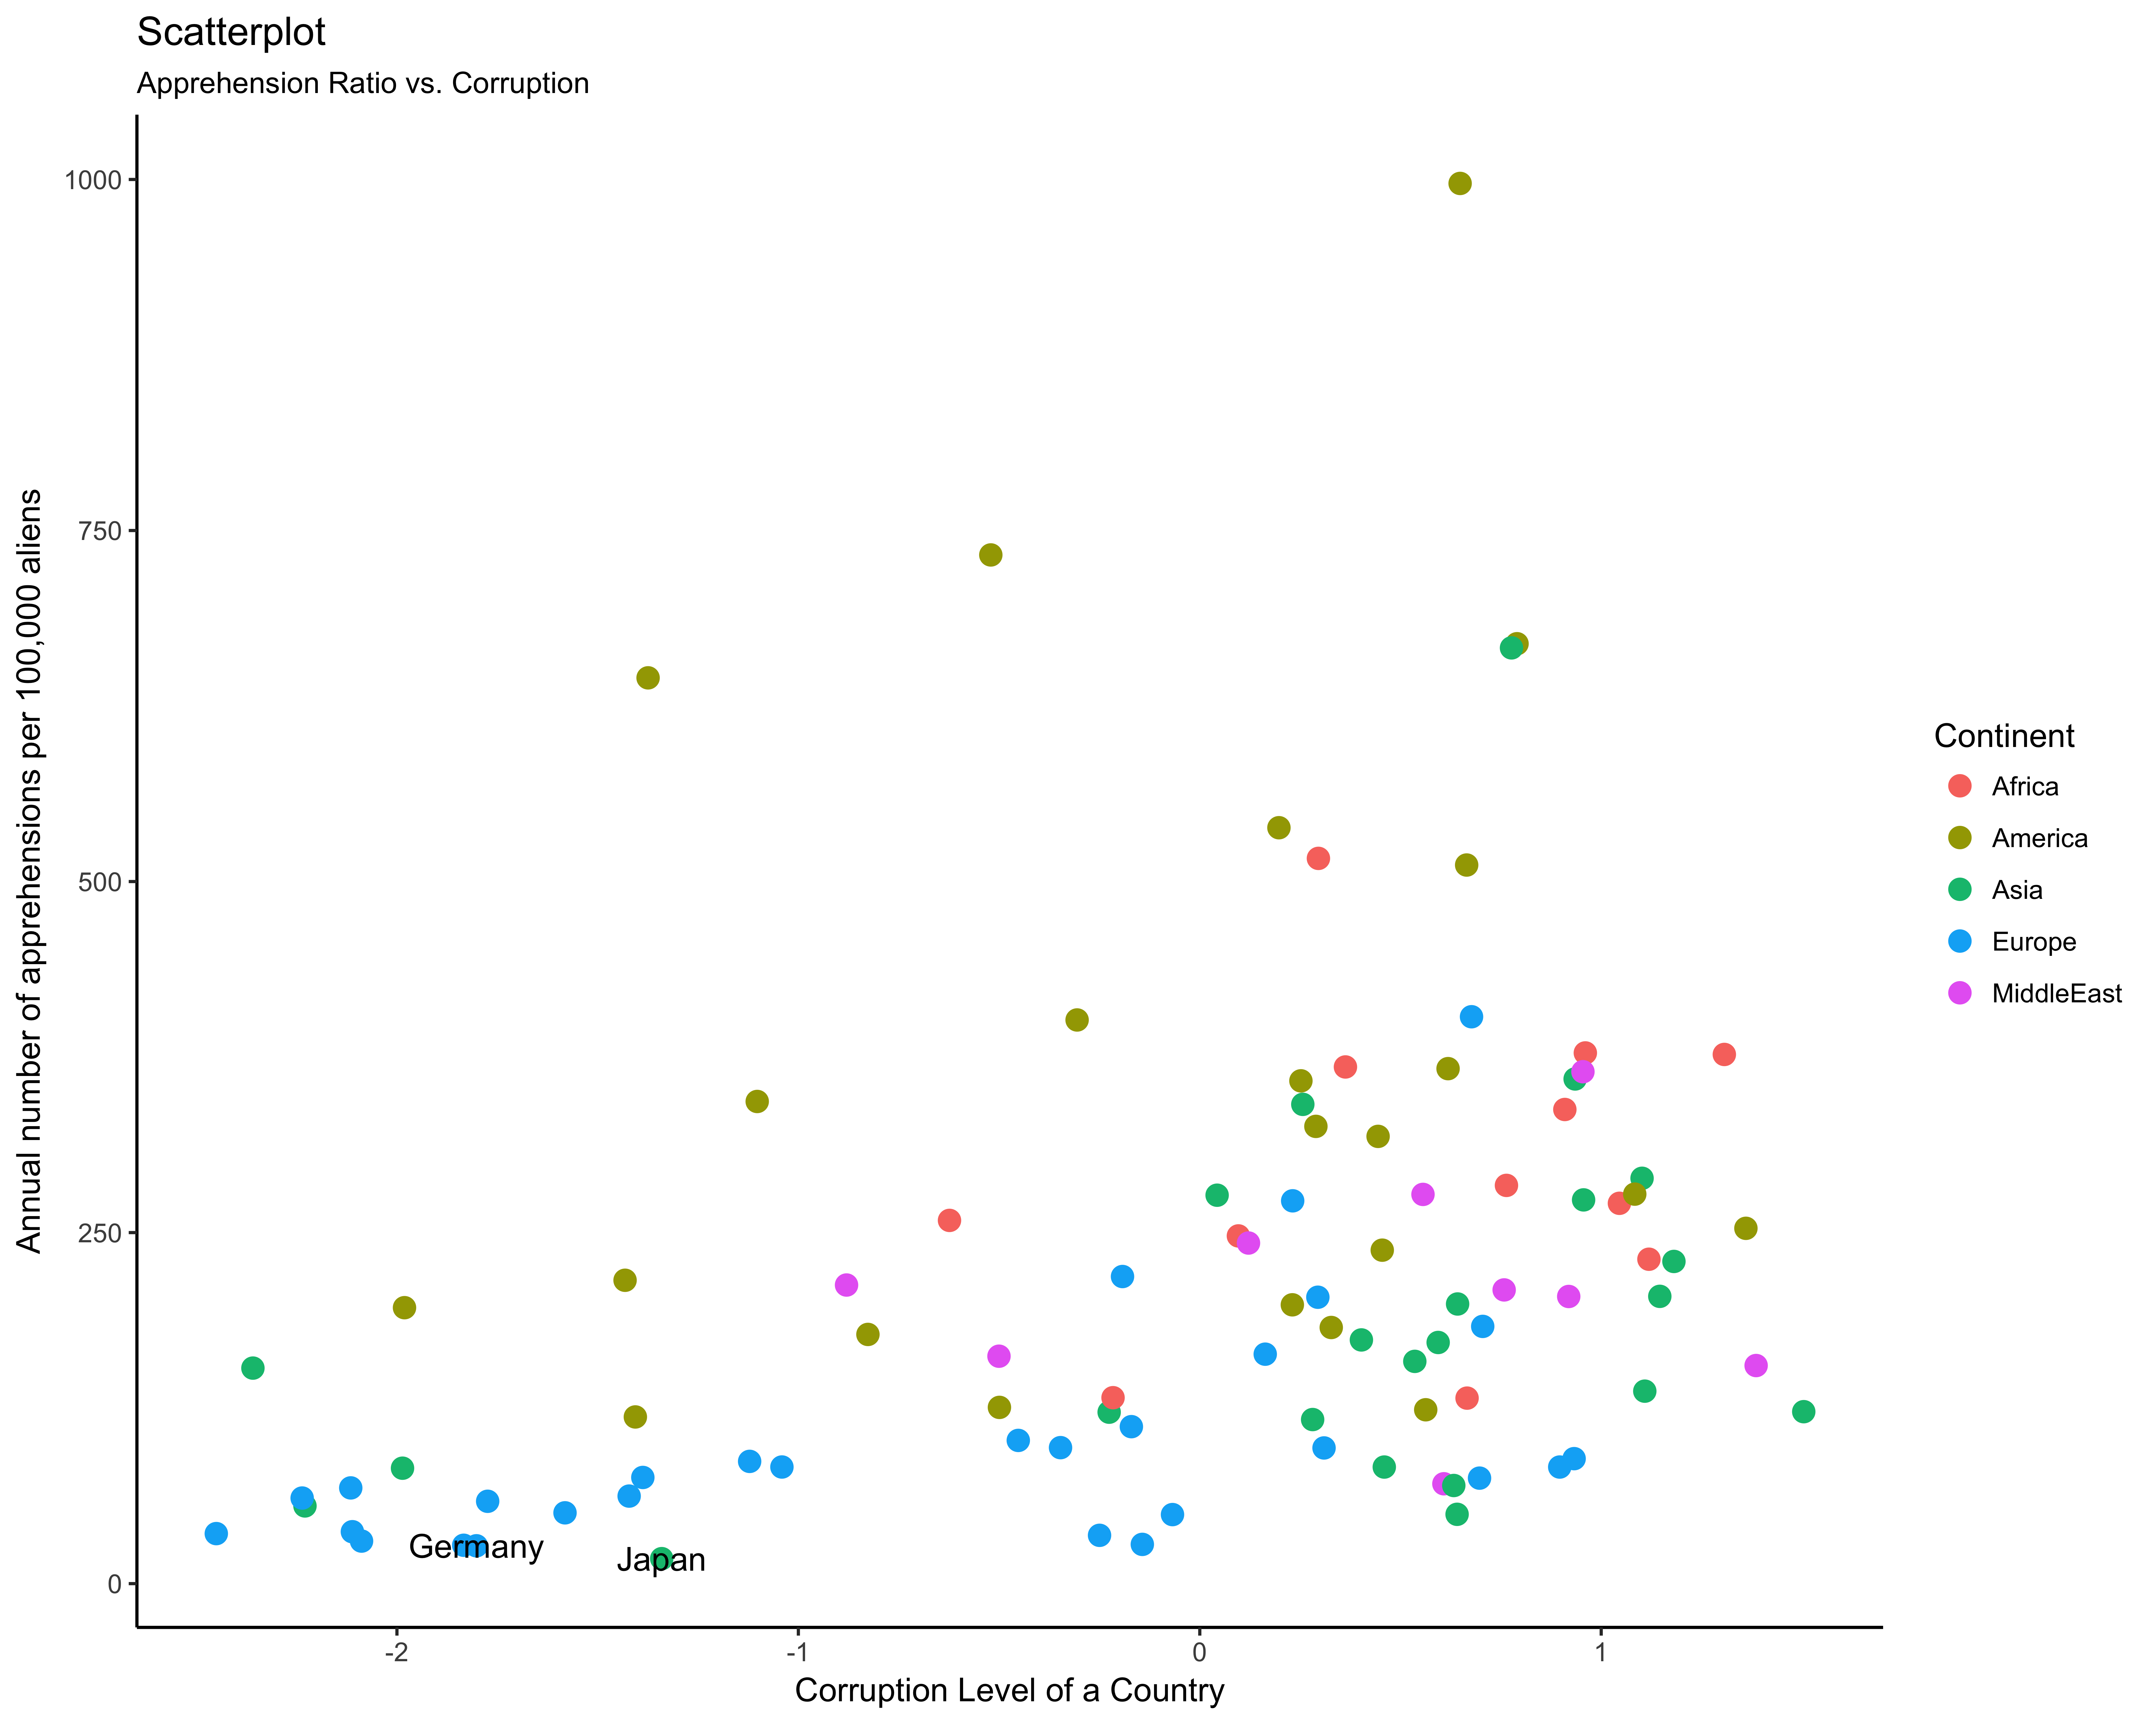
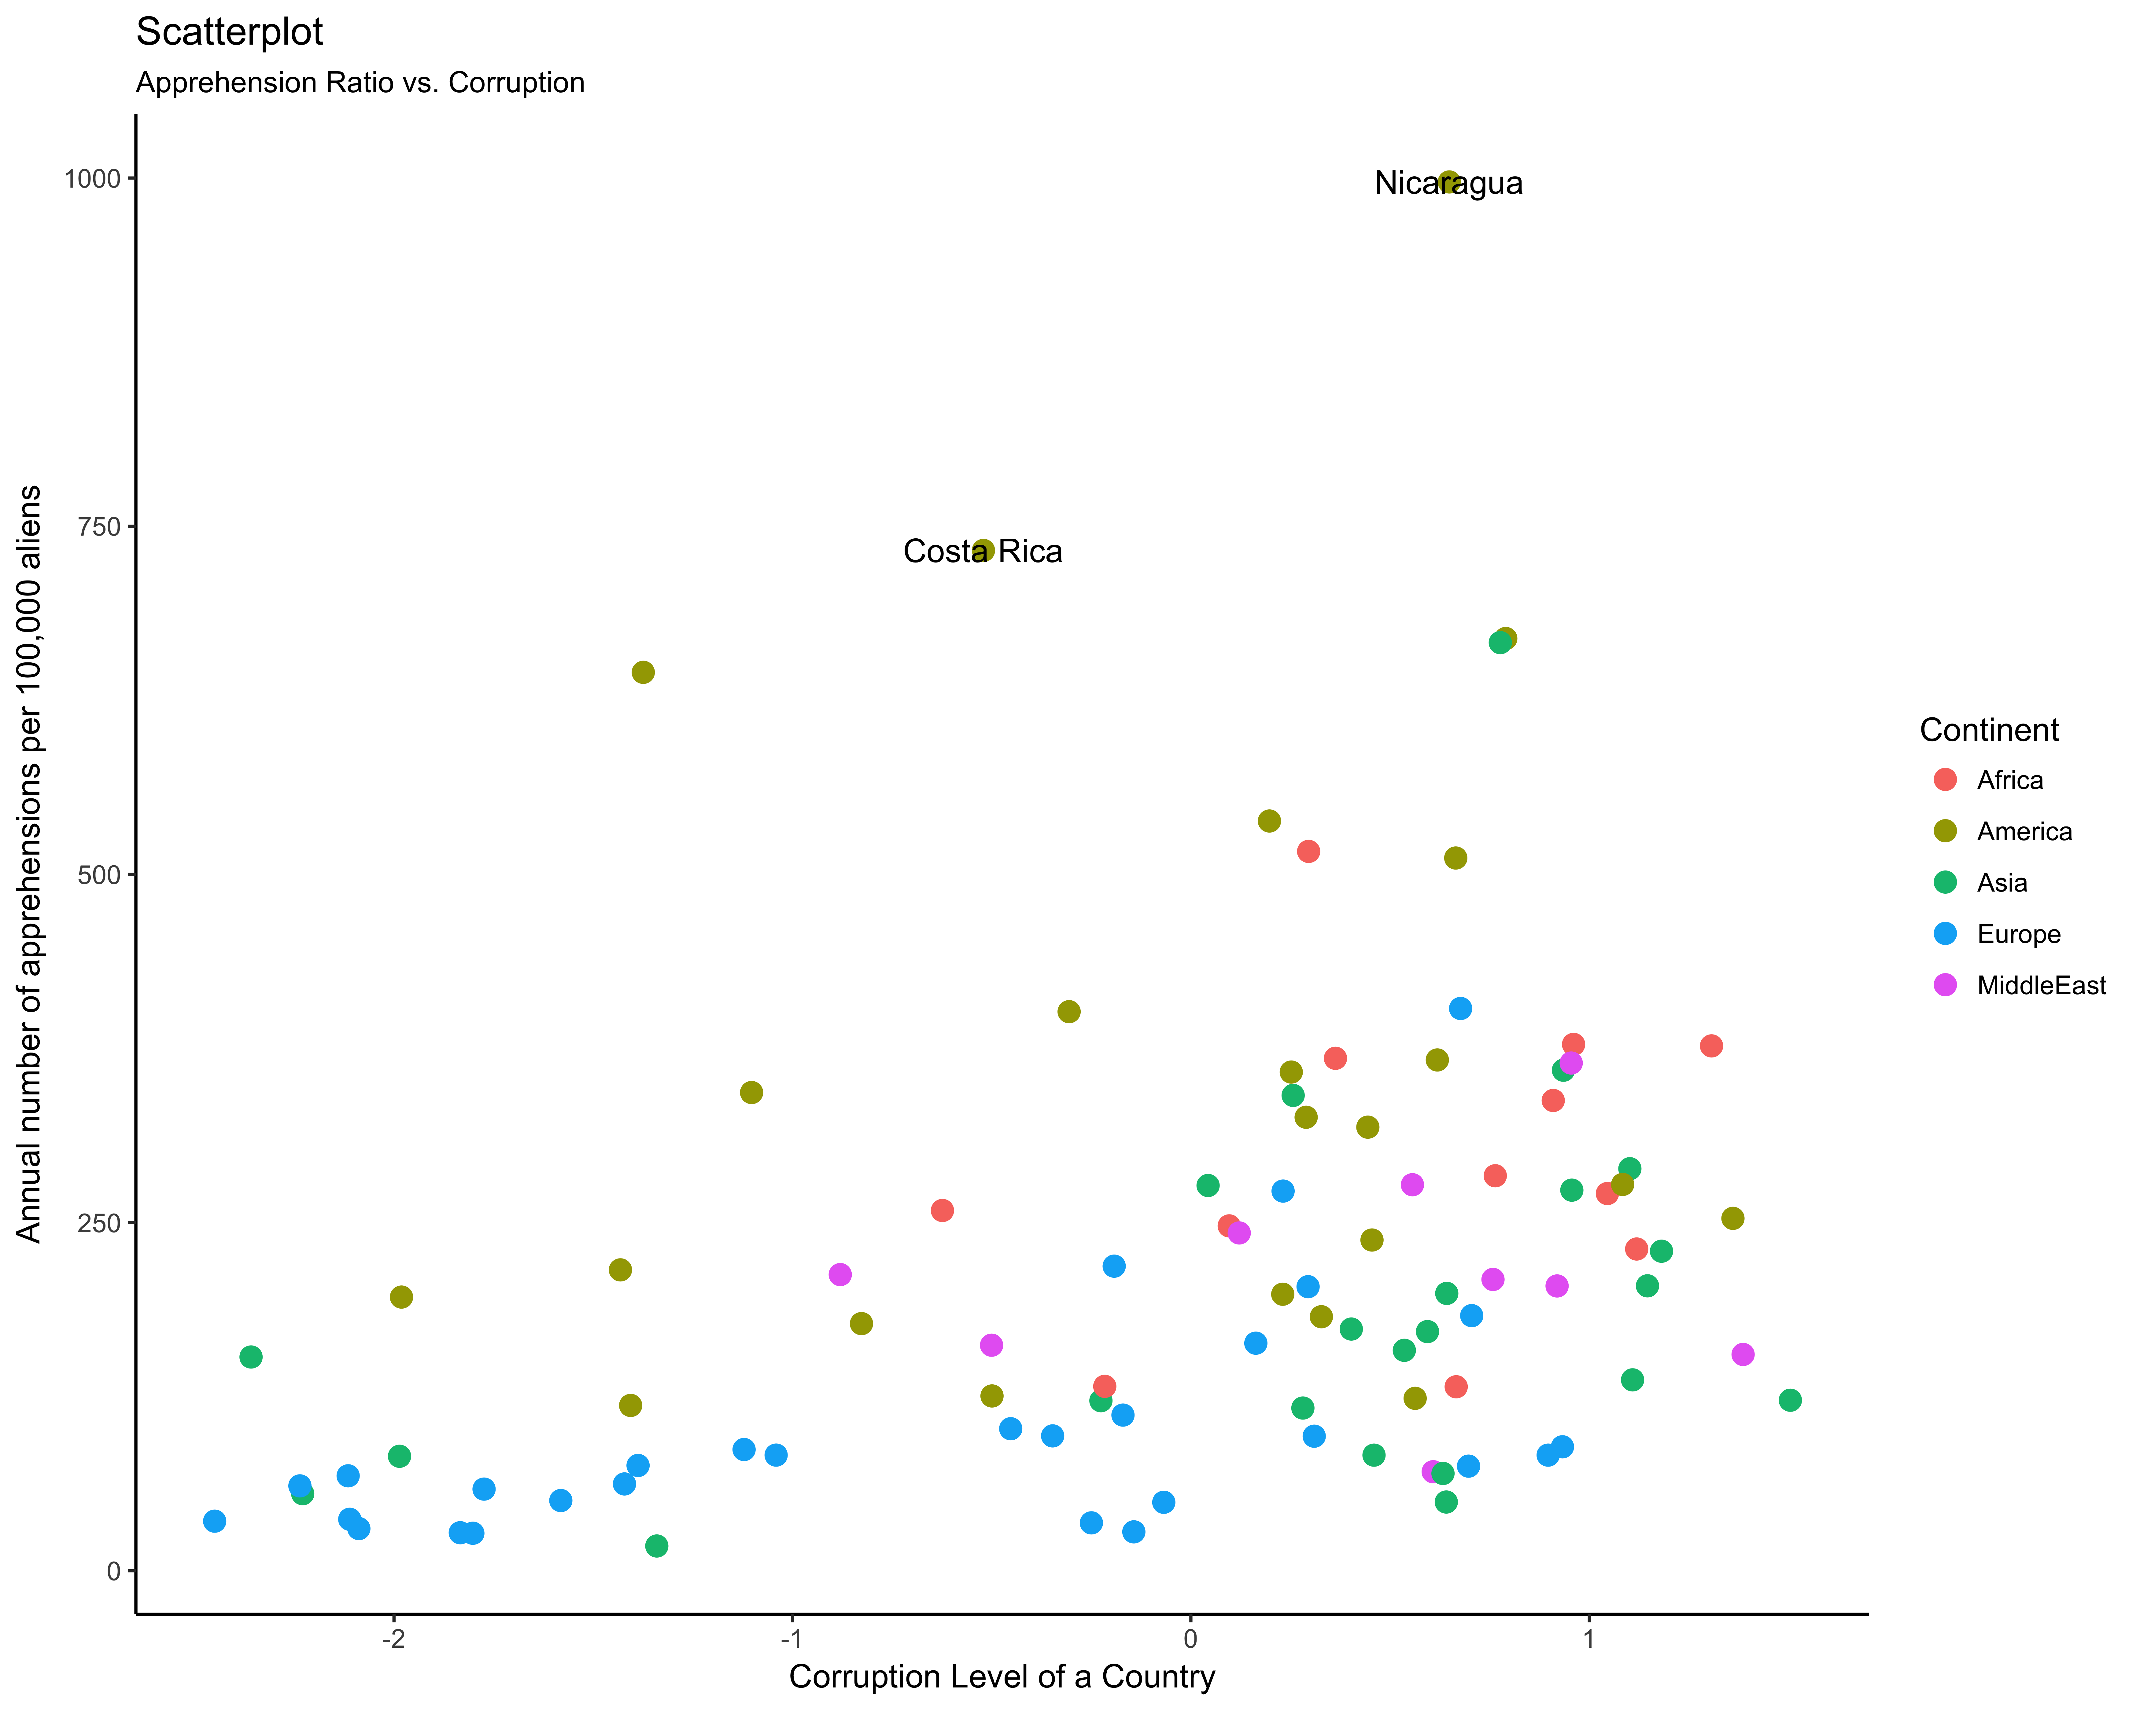
Annual number of apprehensions per 100,000 aliens VS. Corruption Level of a Country
Corruption Scale:
-2.5 to 2.5

Slide 9
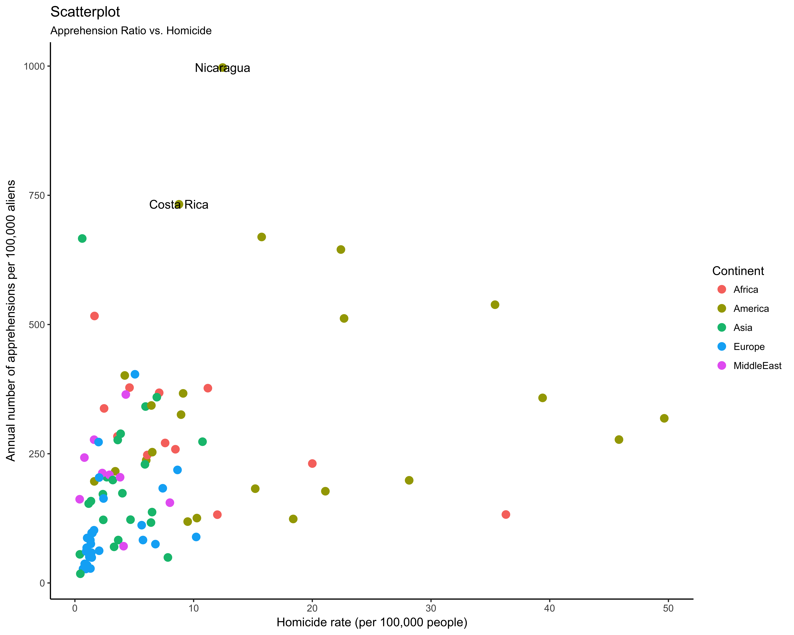
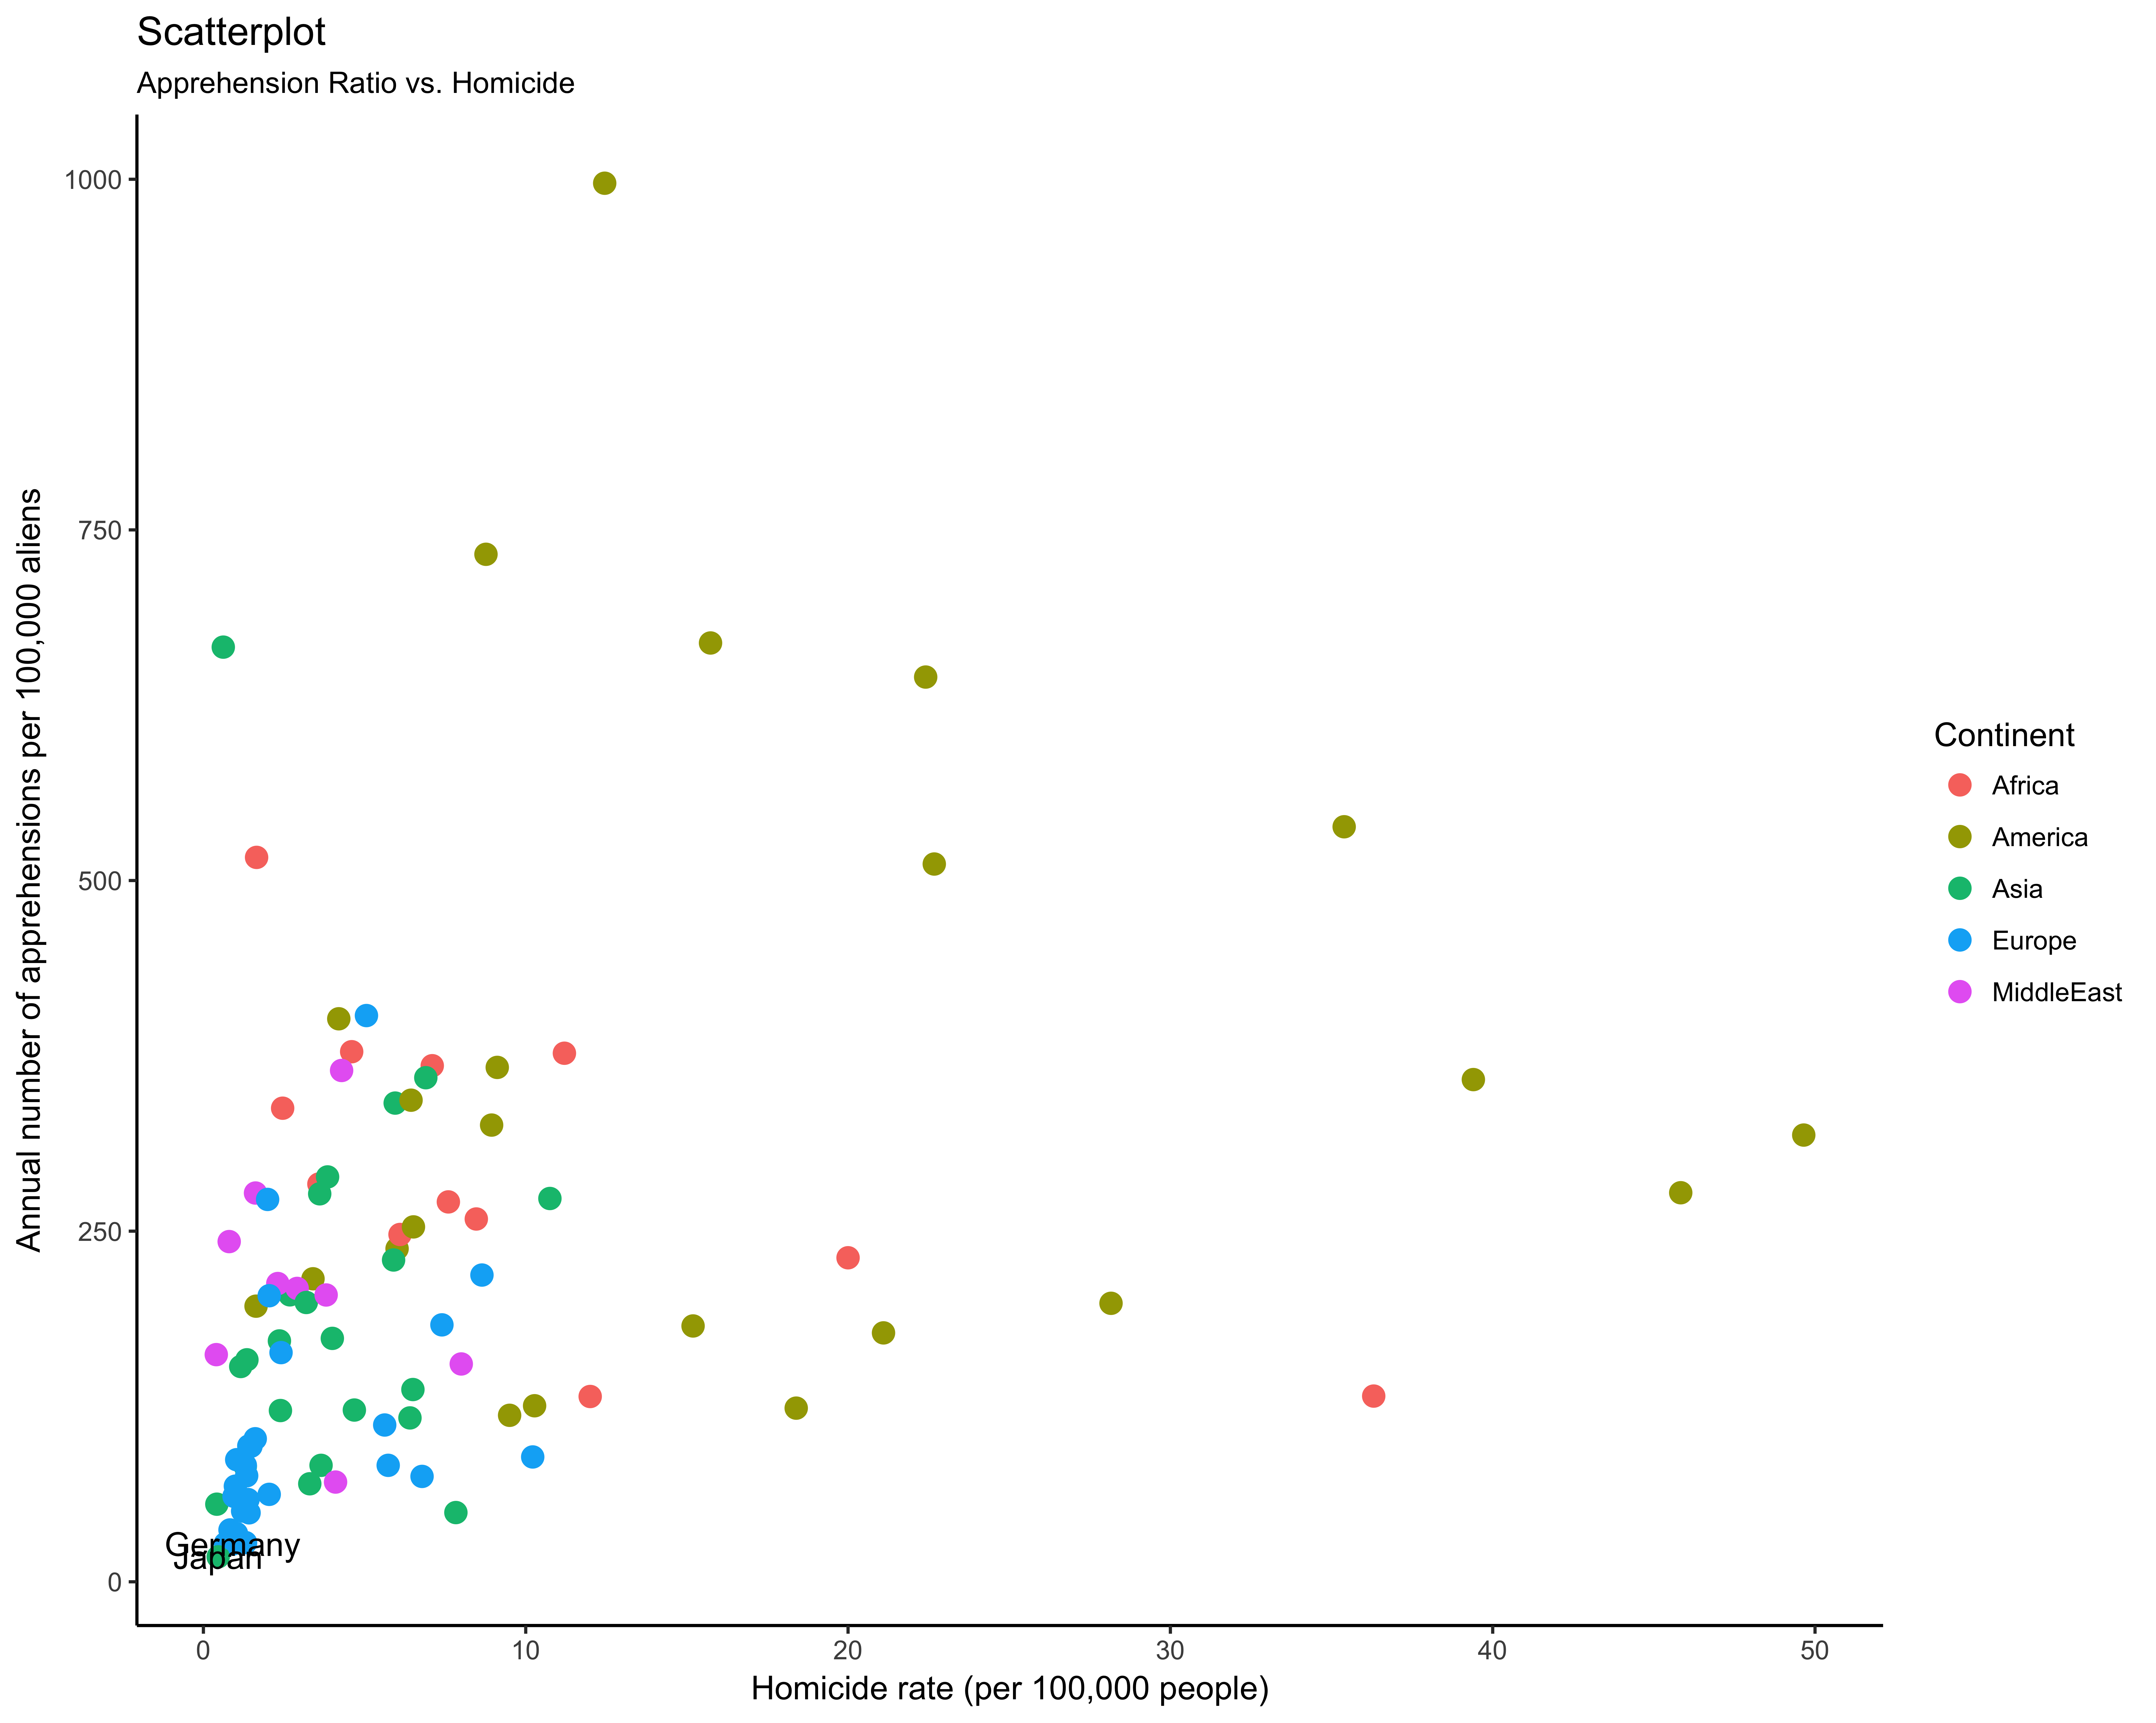
Annual number of apprehensions per 100,000 aliens VS. Homicide rate (per 100,000 people)

Slide 10
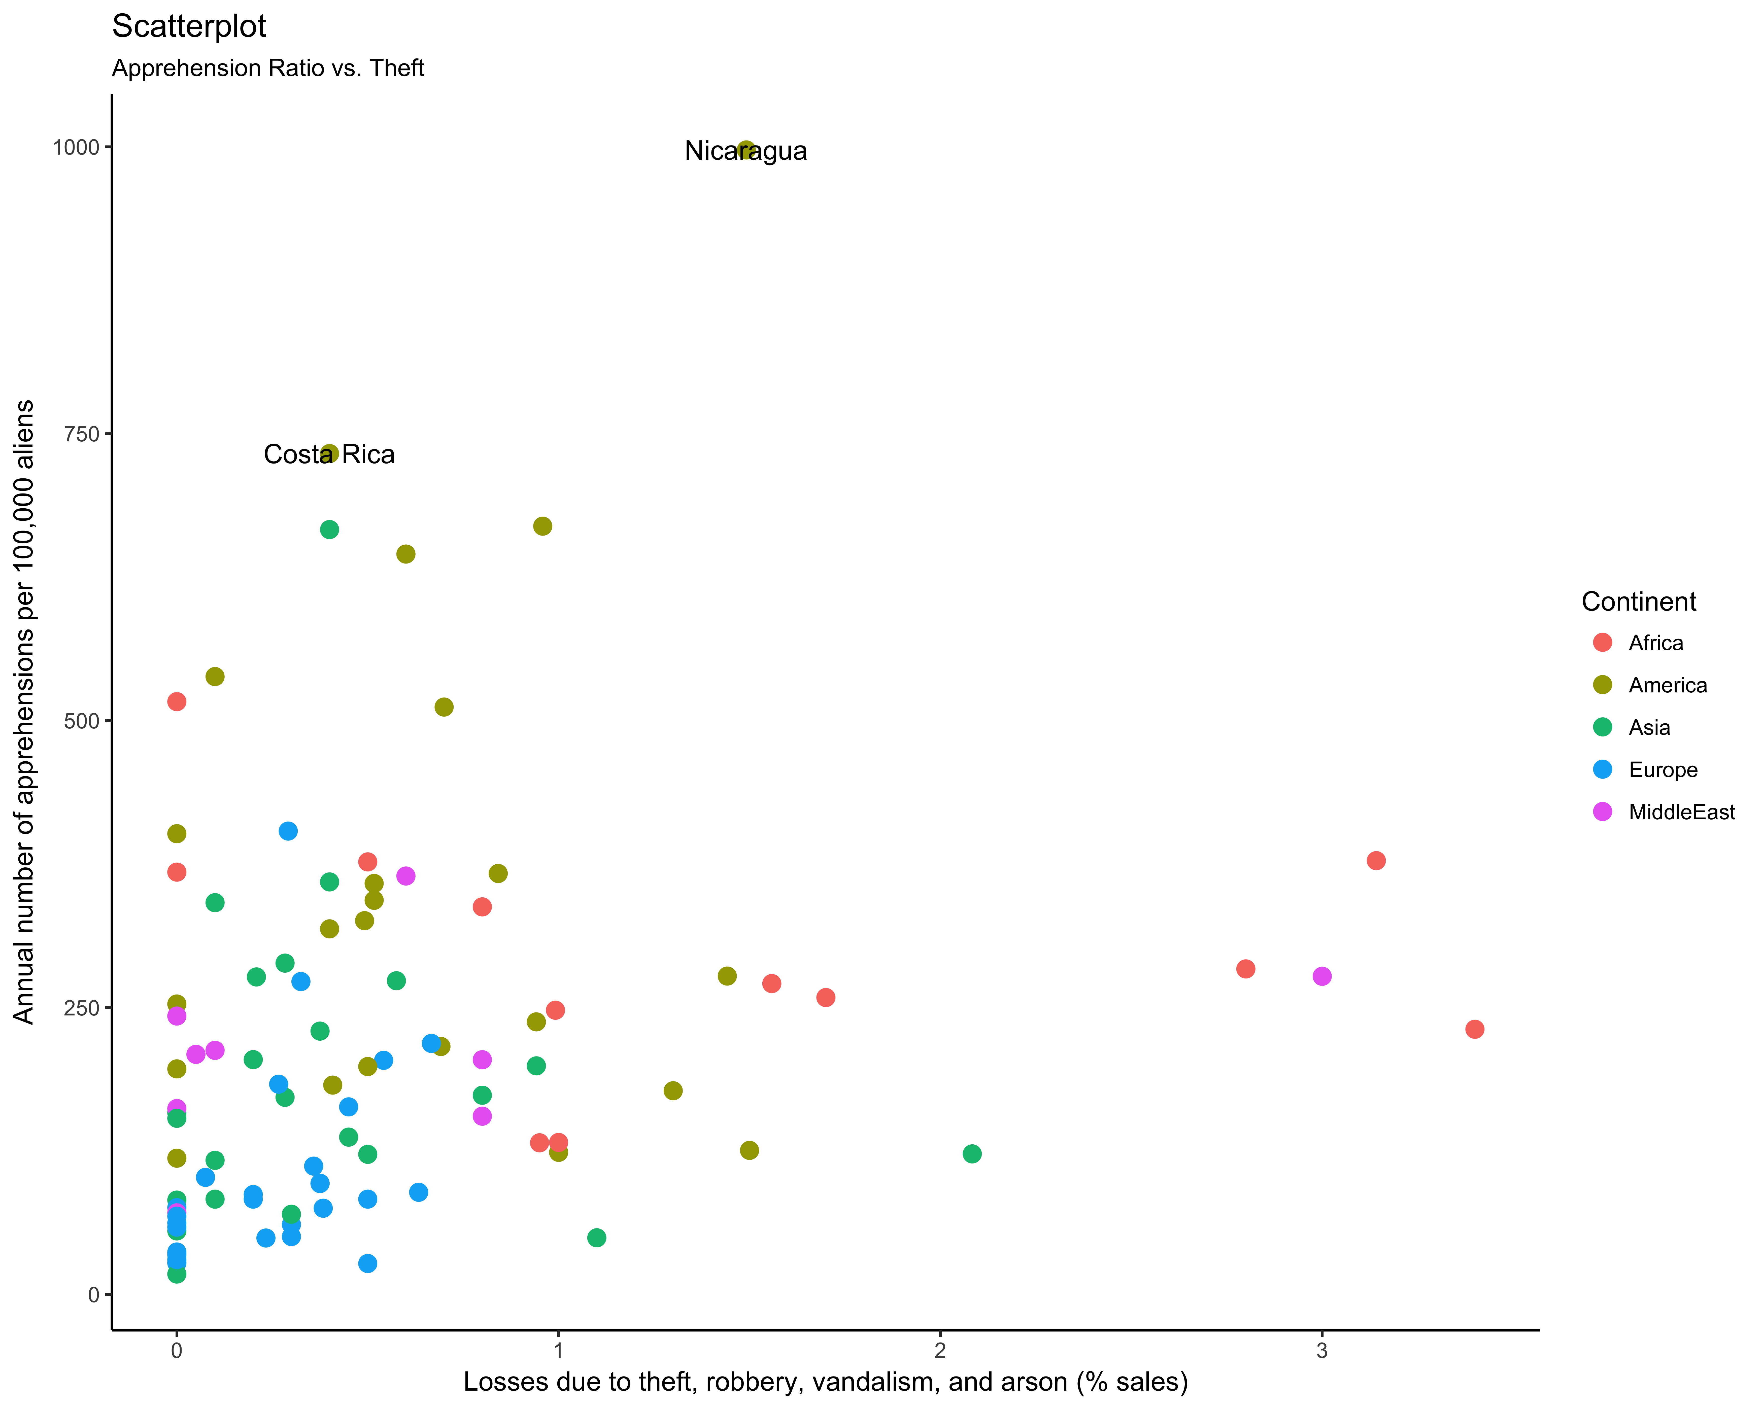
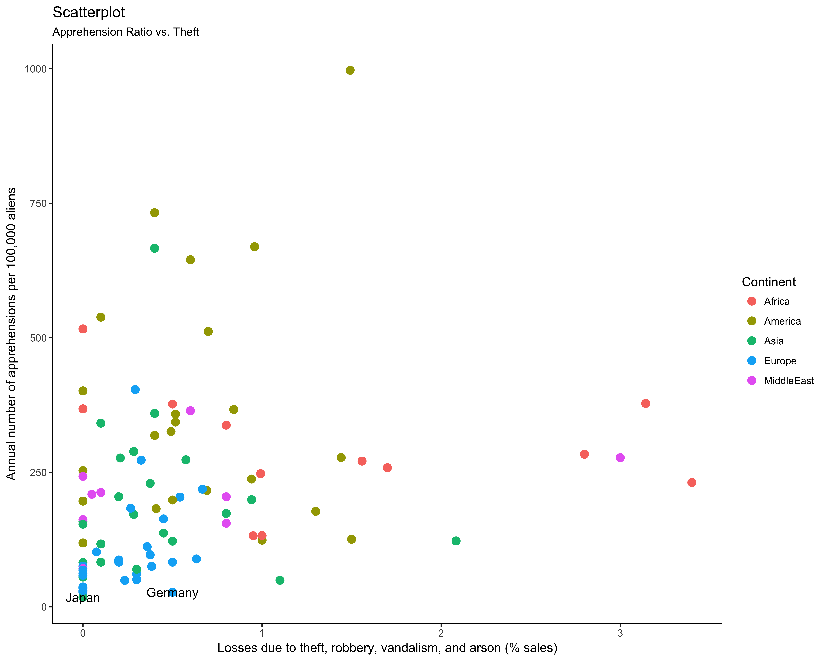
Annual number of apprehensions per 100,000 aliens VS. Losses due to theft, robbery, vandalism, and arson (% sales)

Slide 11
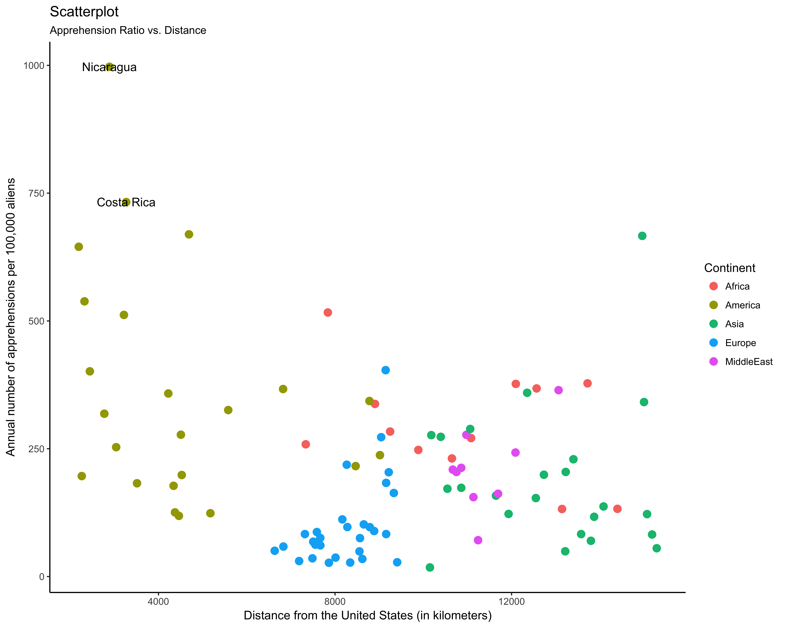
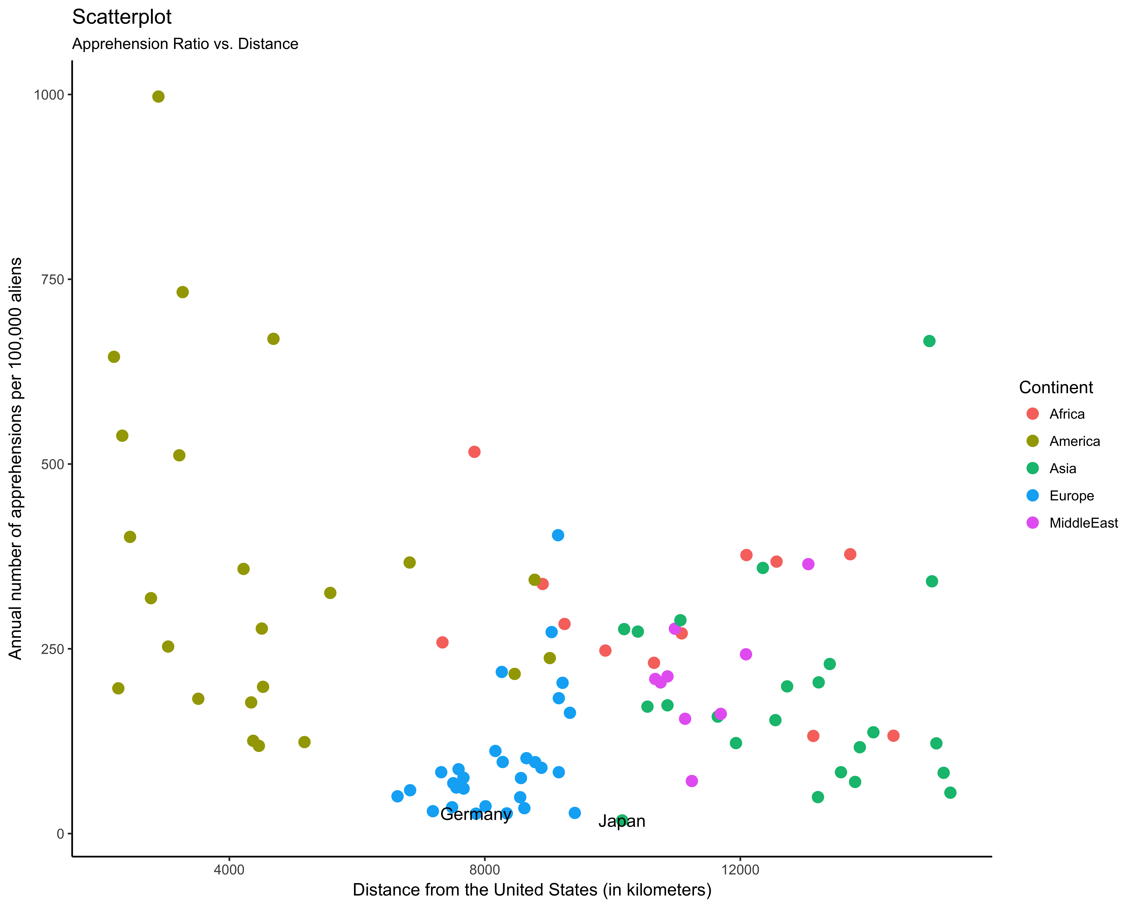
Annual number of apprehensions per 100,000 aliens VS. the distance from the United States (in kilometers)

Slide 12
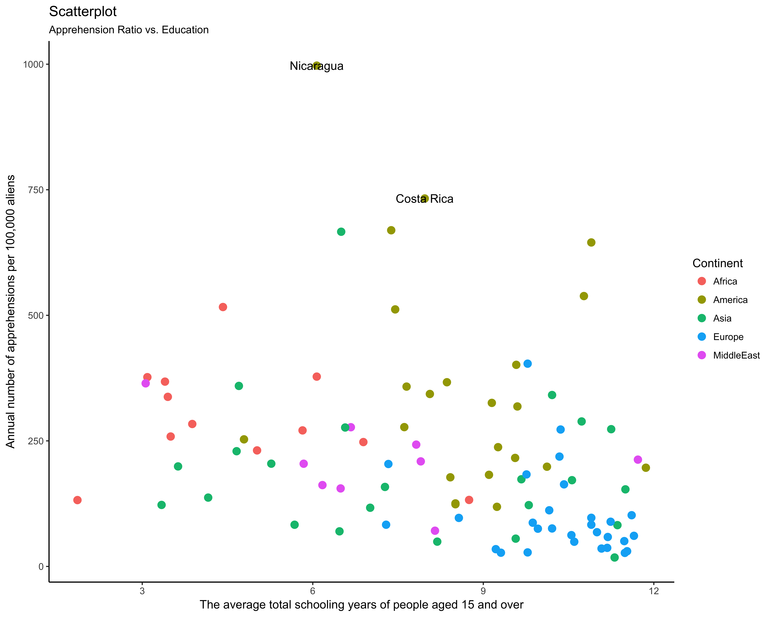
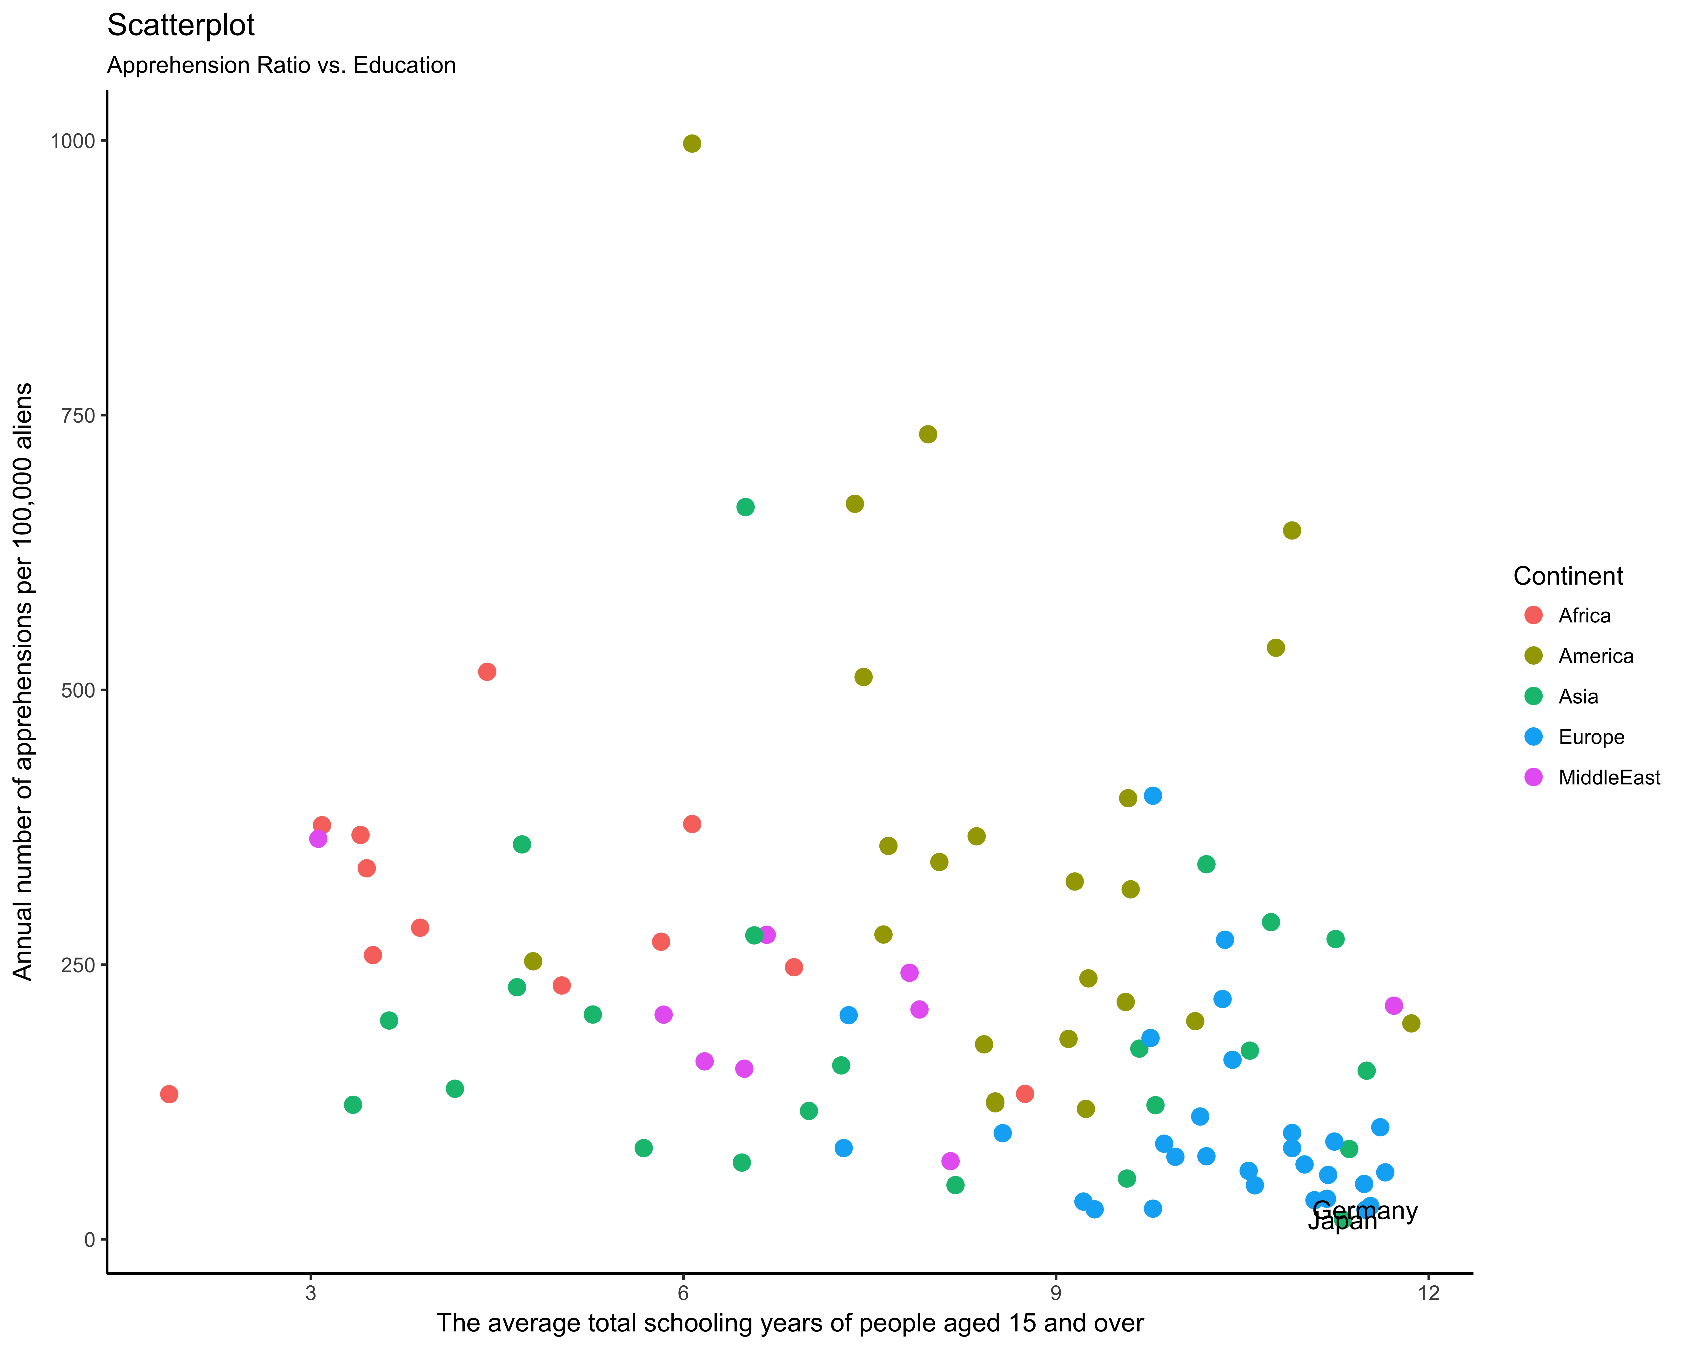
Annual number of apprehensions per 100,000 aliens VS. the average total schooling years of people aged 15 and over

Slide 13
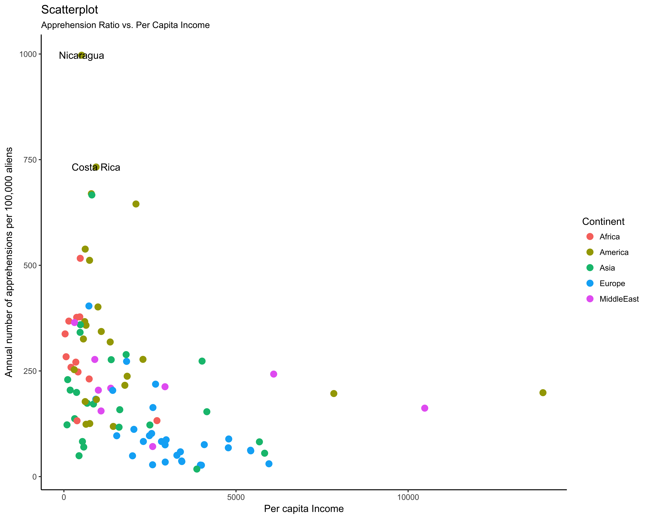

Annual number of apprehensions per 100,000 aliens VS. per capita income

Slide 14
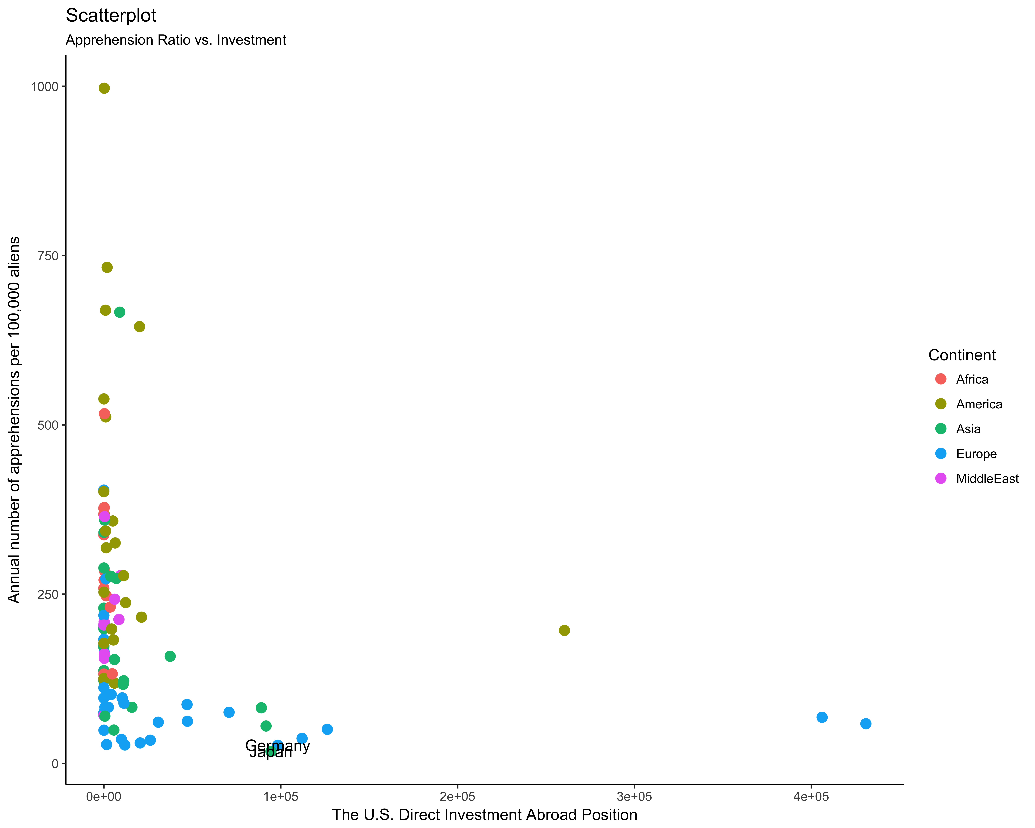
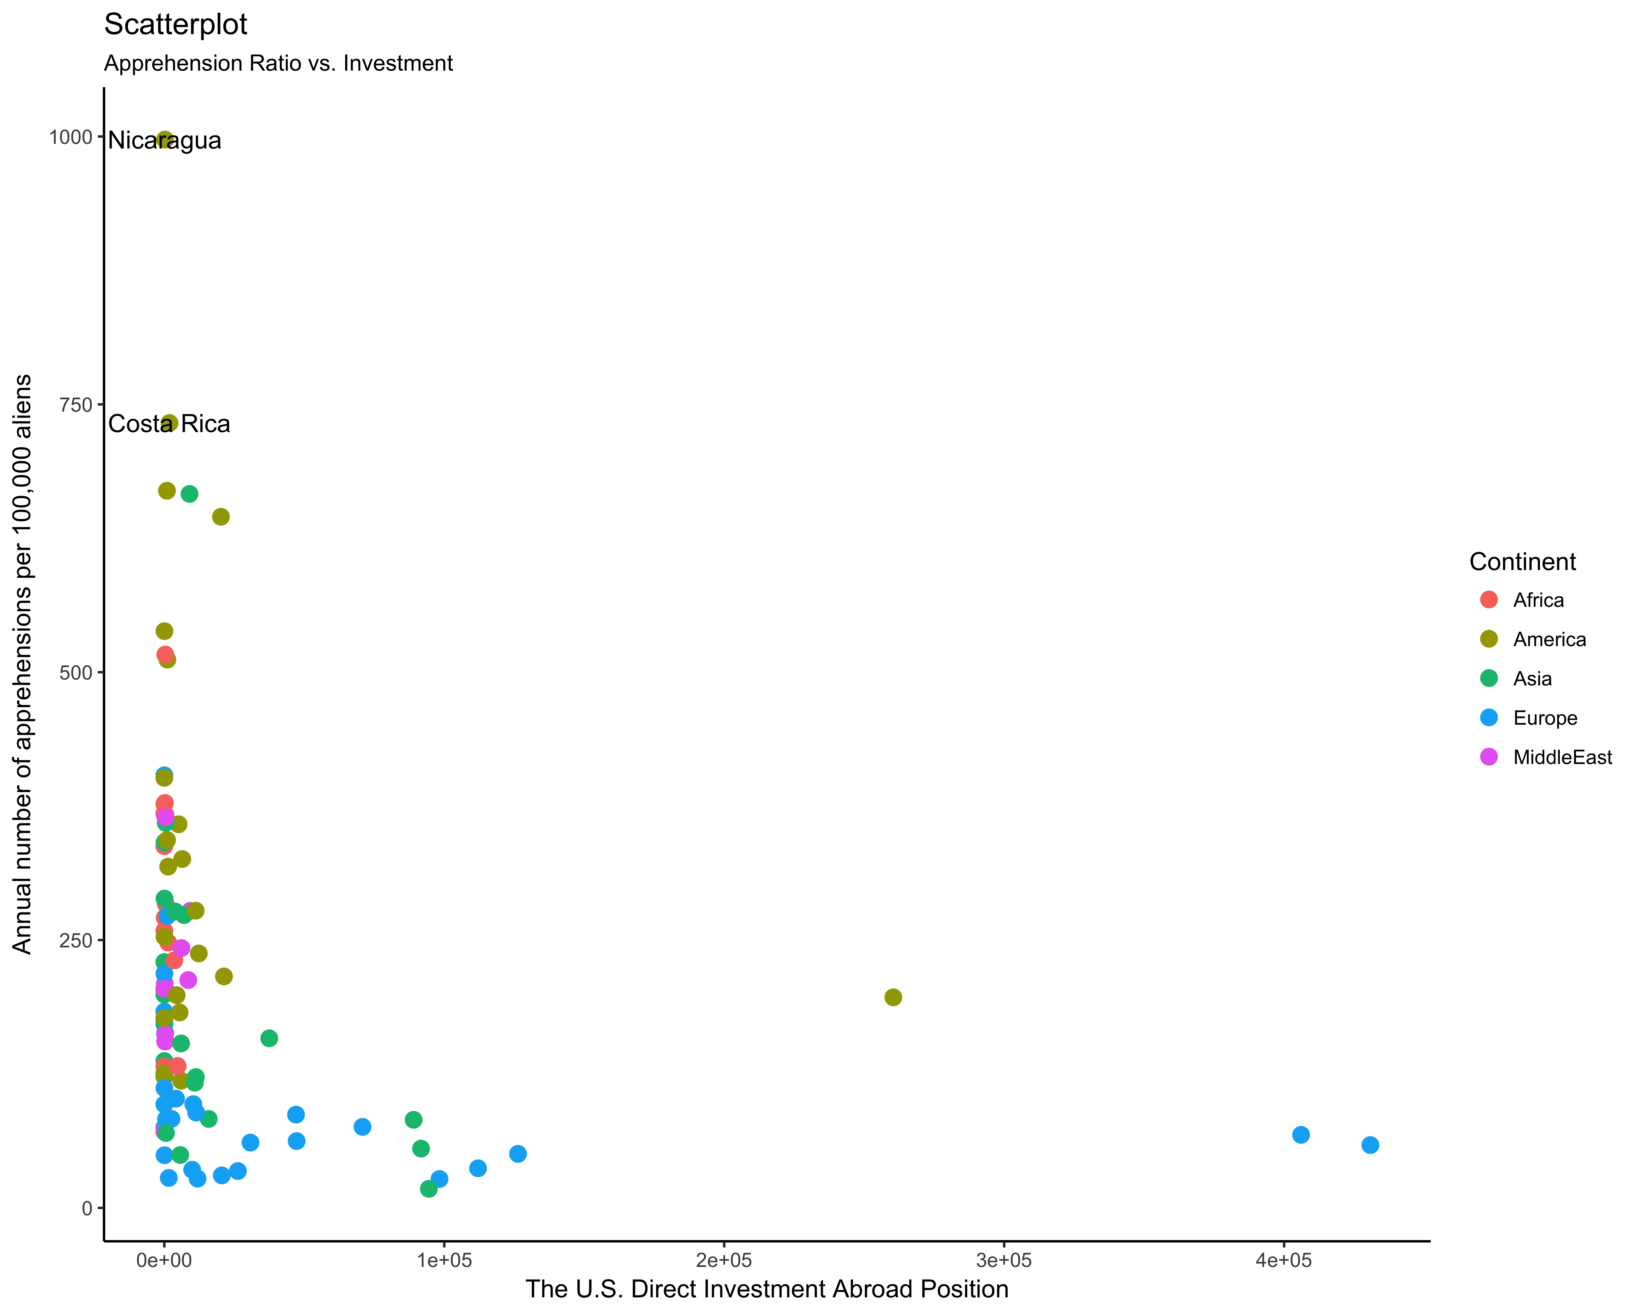
Annual number of apprehensions per 100,000 aliens VS. The U.S. Direct Investment Abroad Position

Slide 15
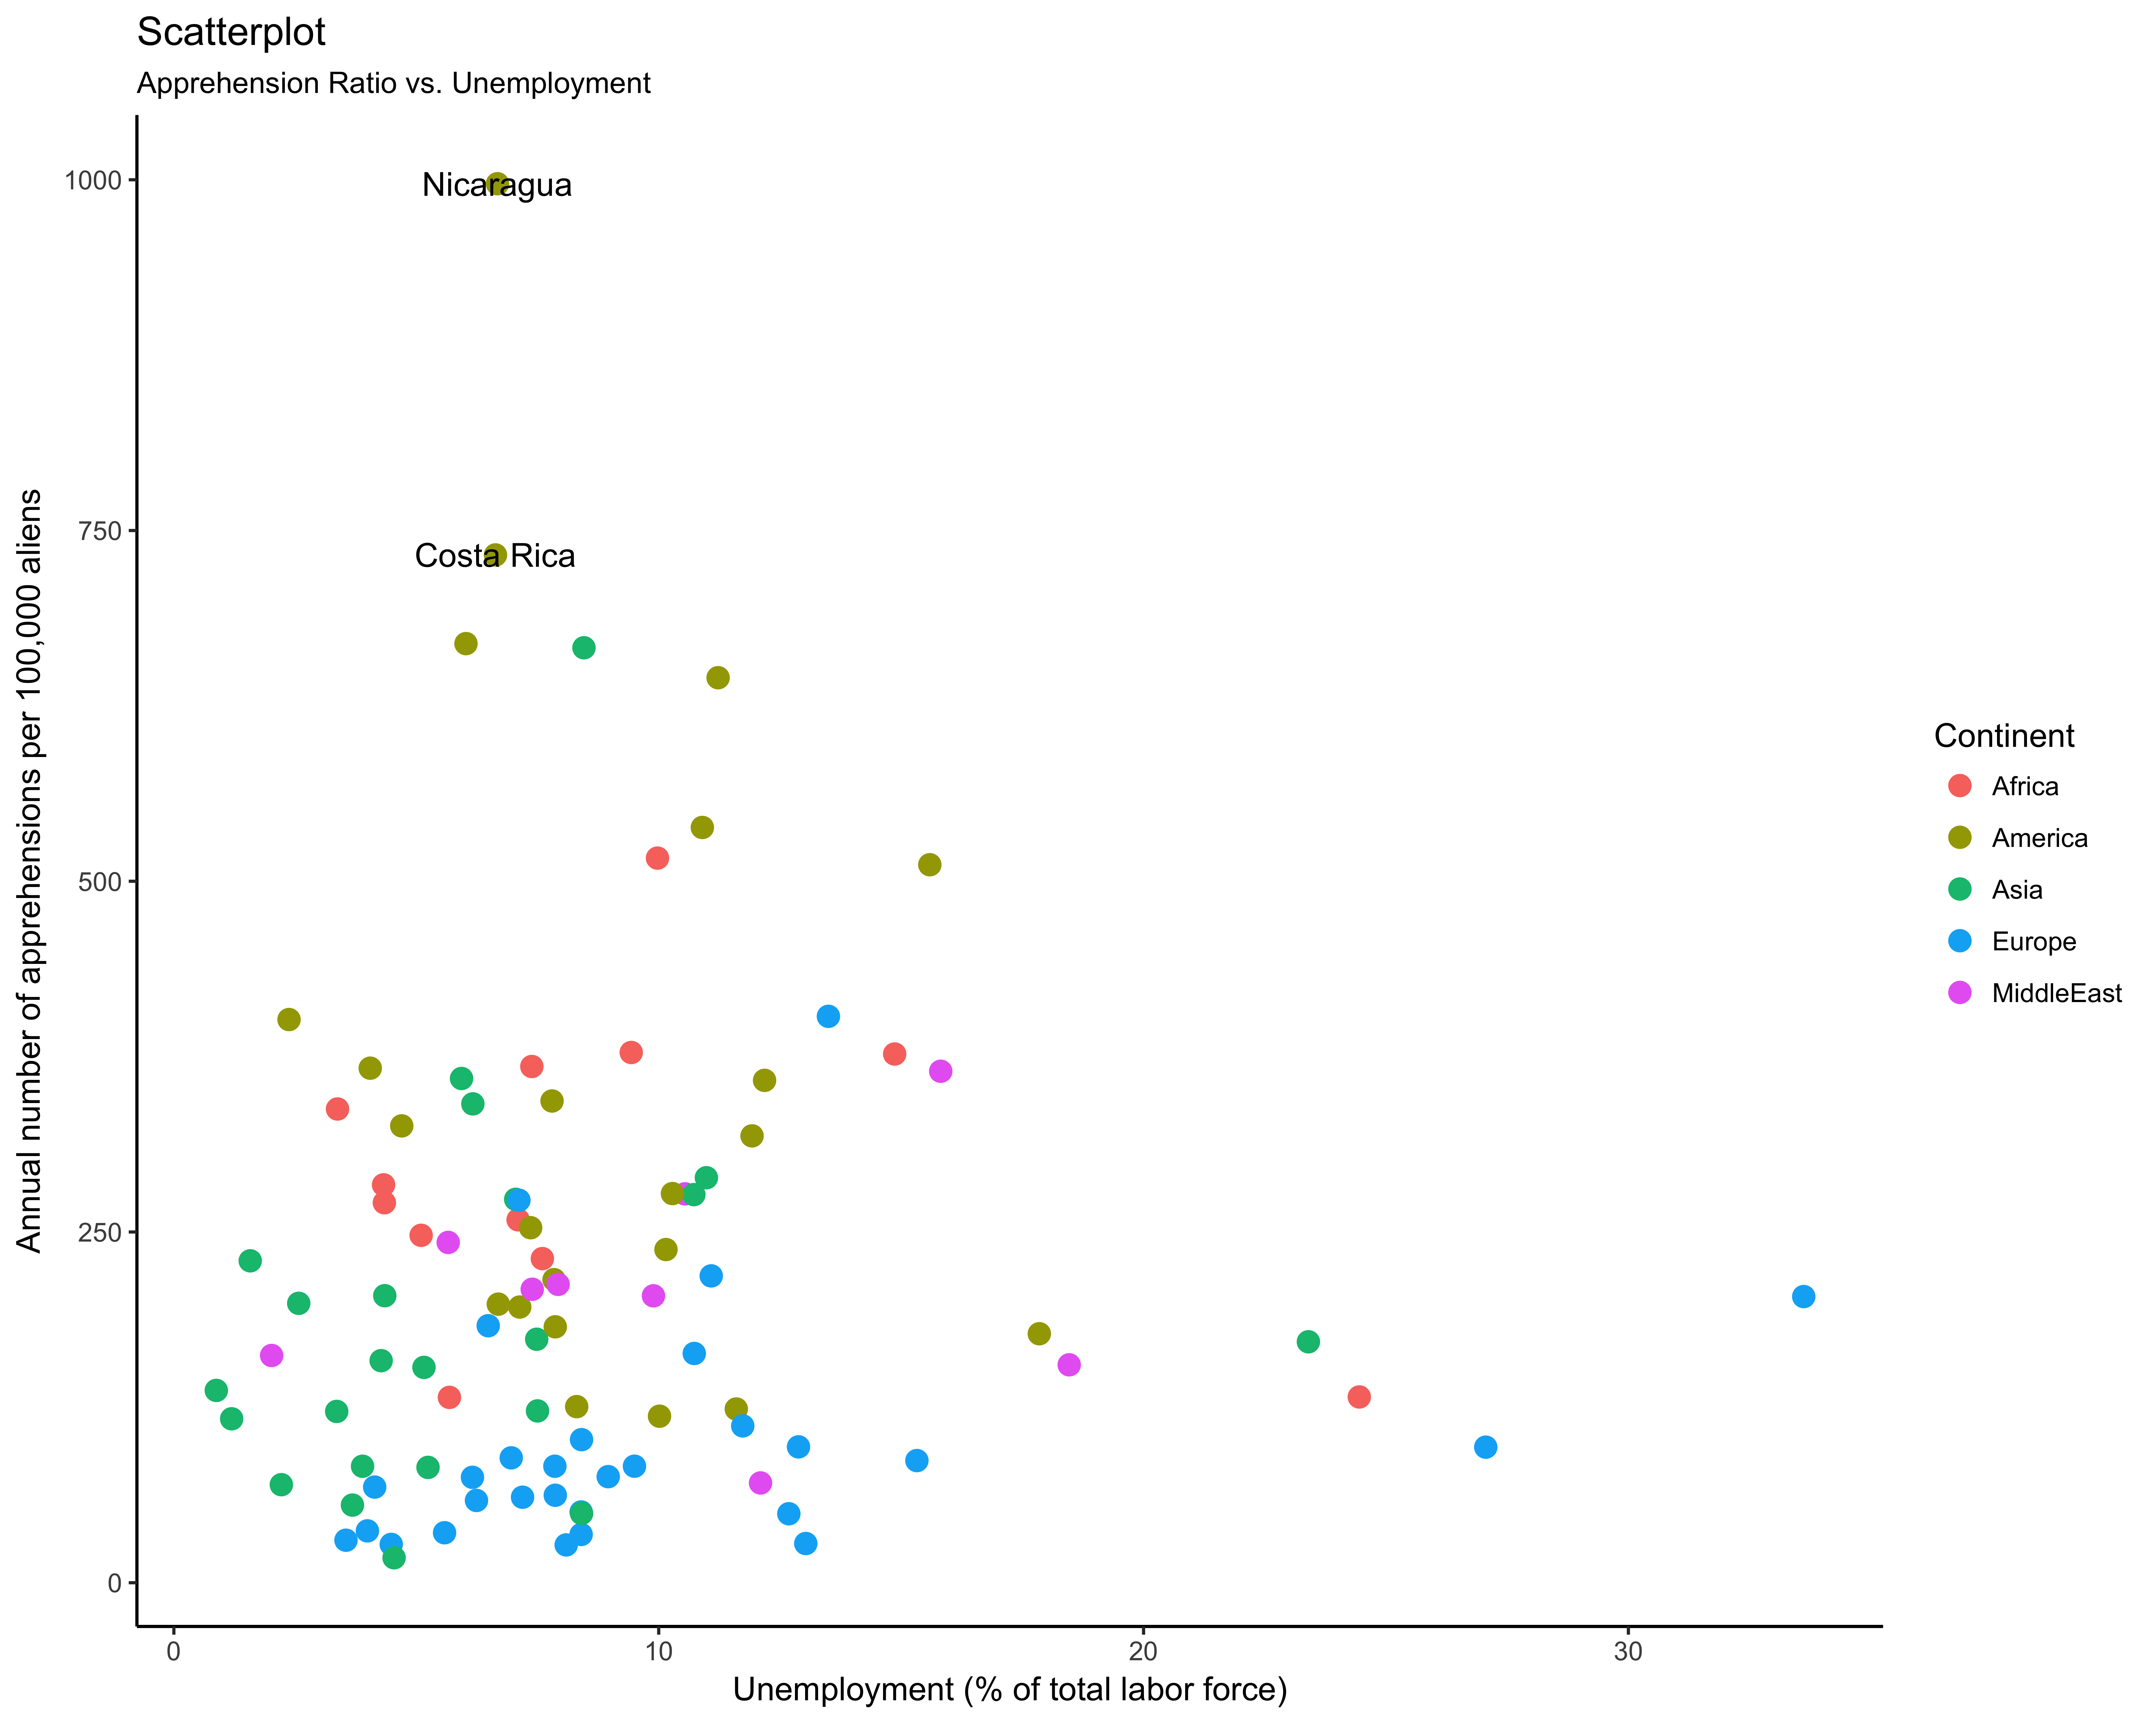
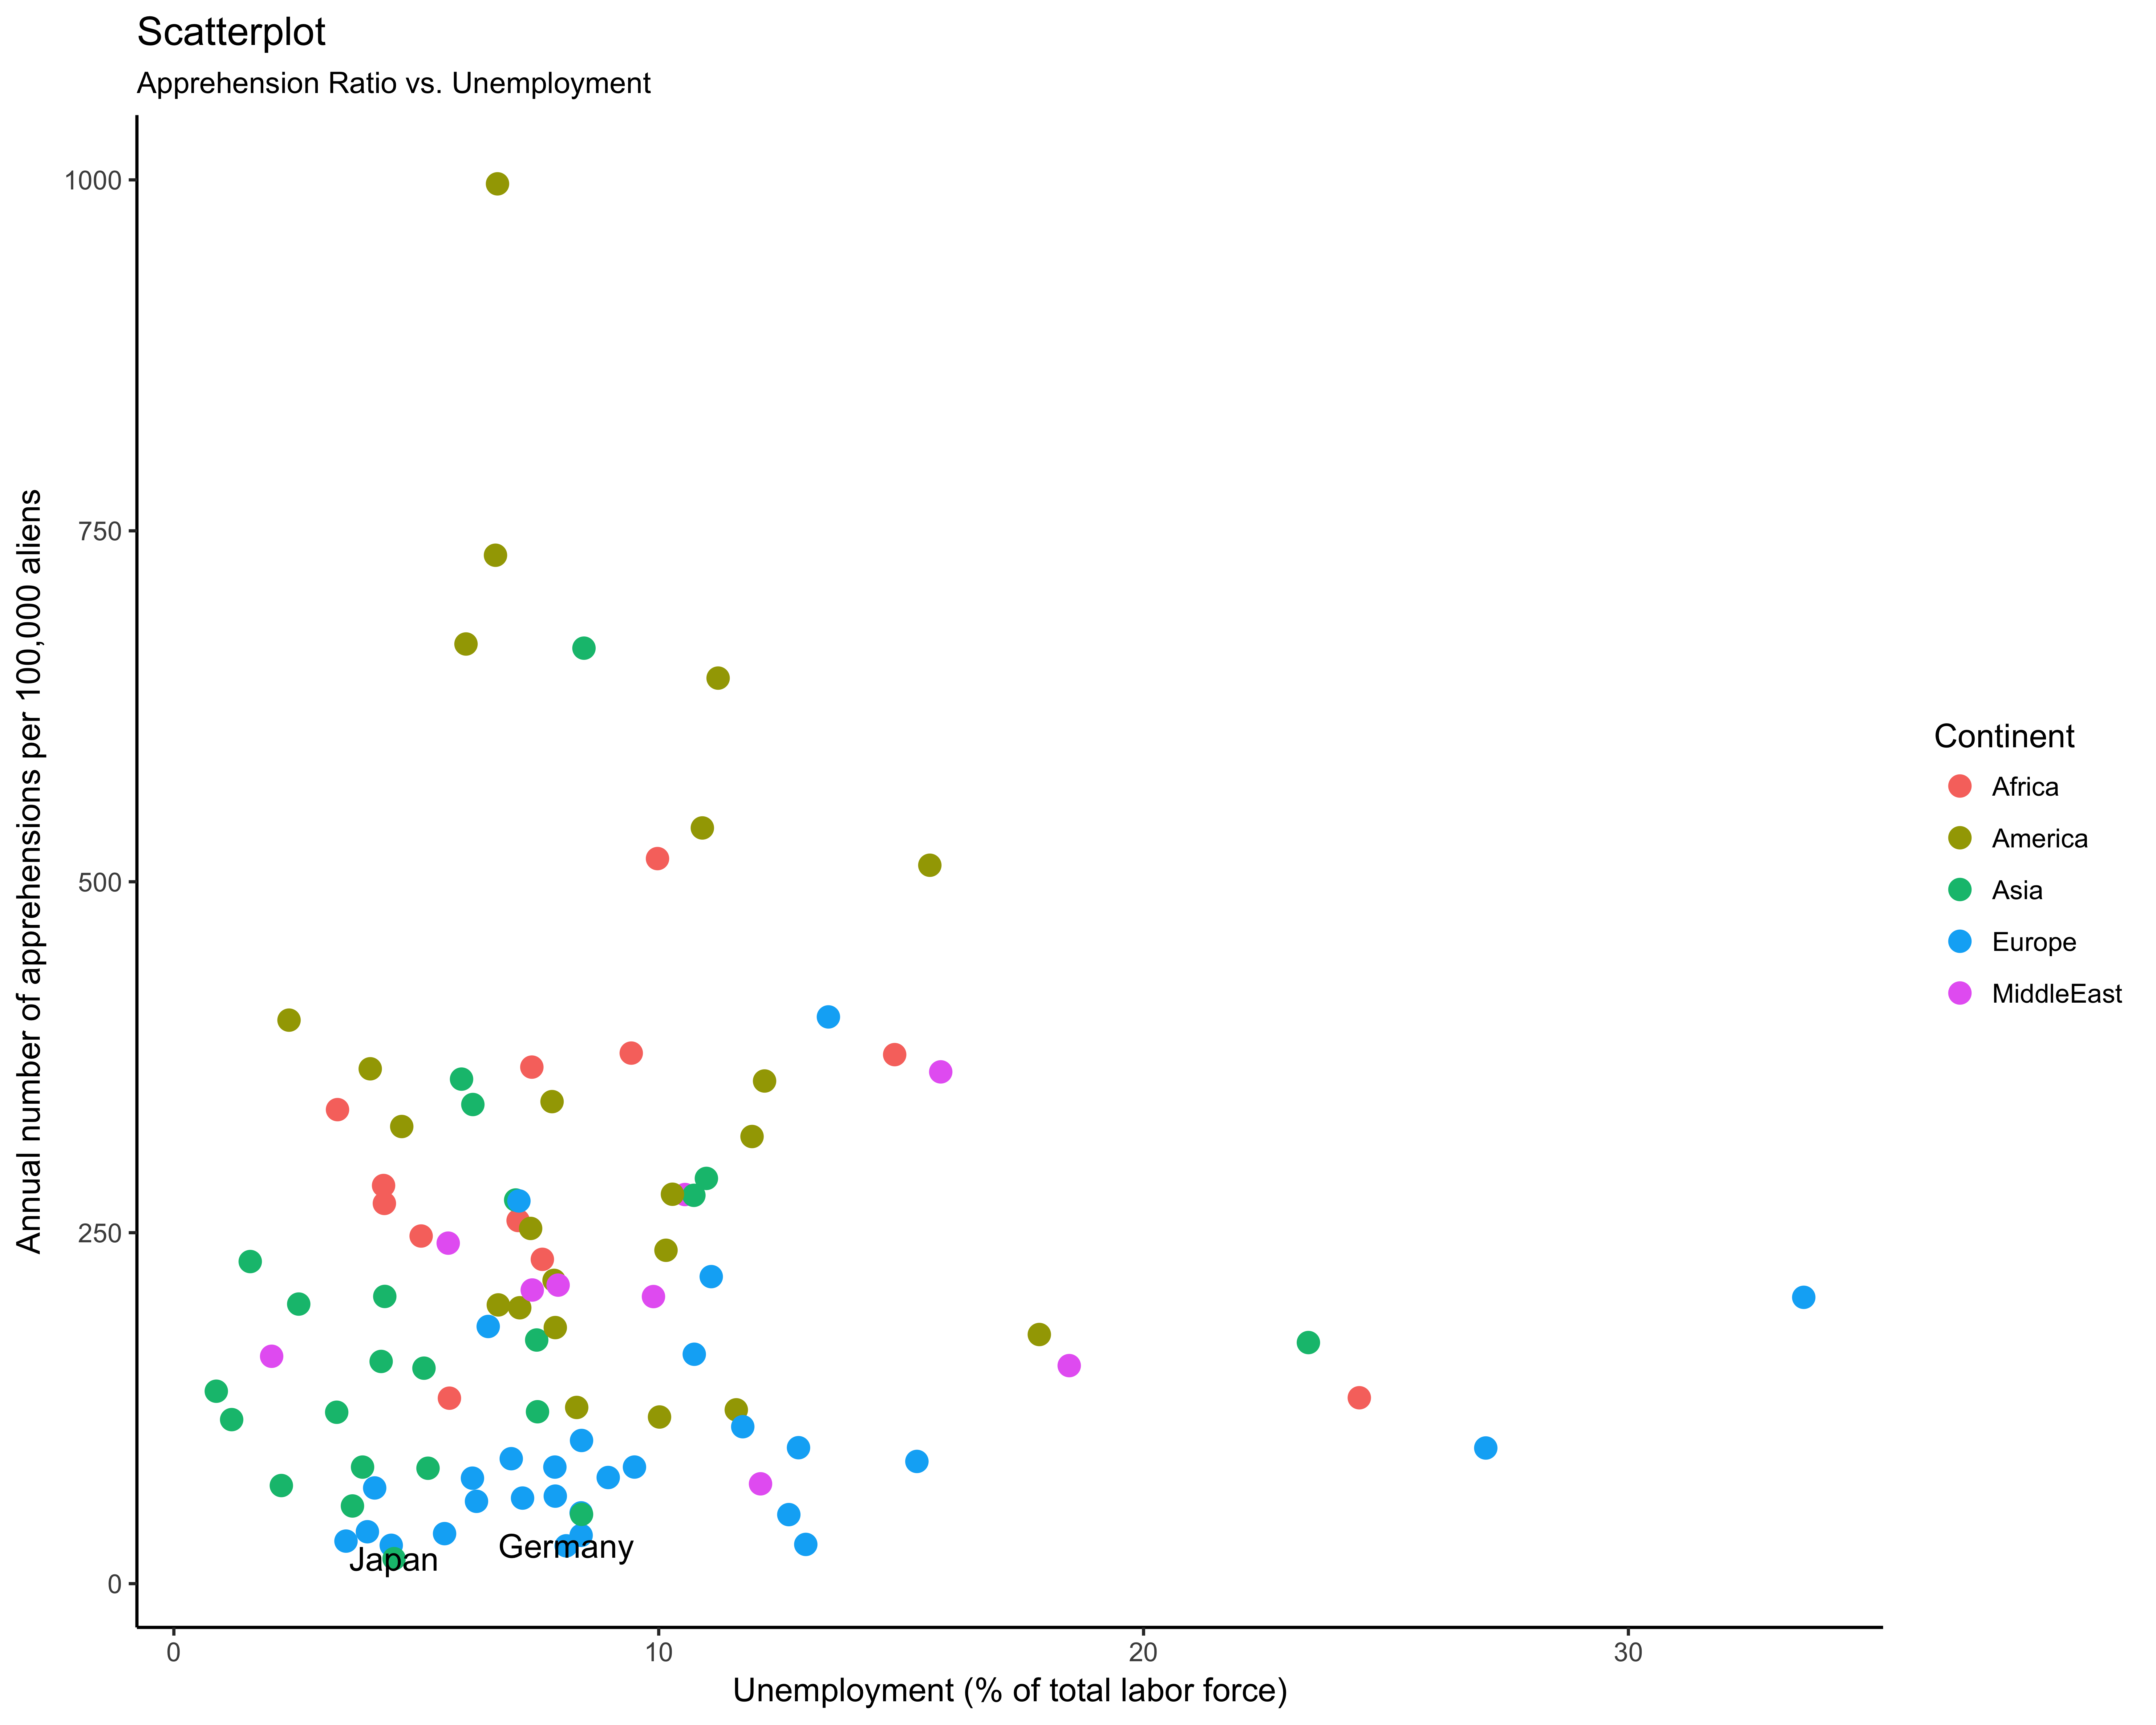
Annual number of apprehensions per 100,000 aliens VS. Unemployment (% of total labor force)

Slide 16
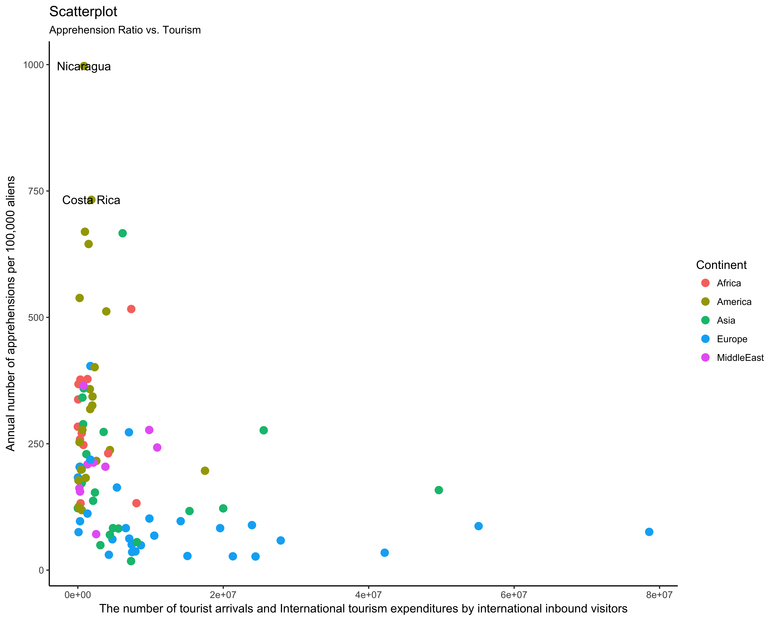
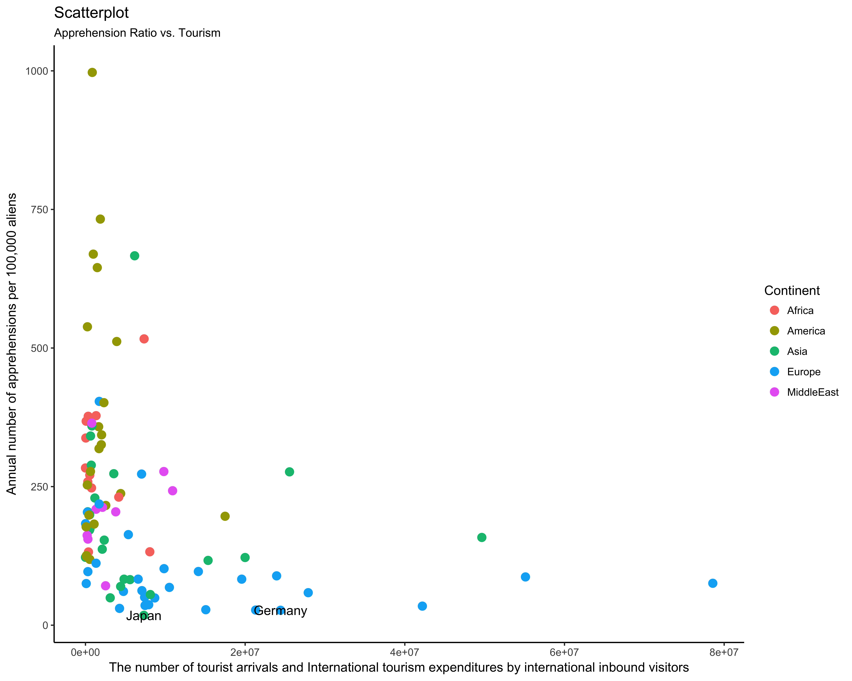
Annual number of apprehensions per 100,000 aliens VS. The number of tourist arrivals and International tourism expenditures by international inbound visitors

Slide 17
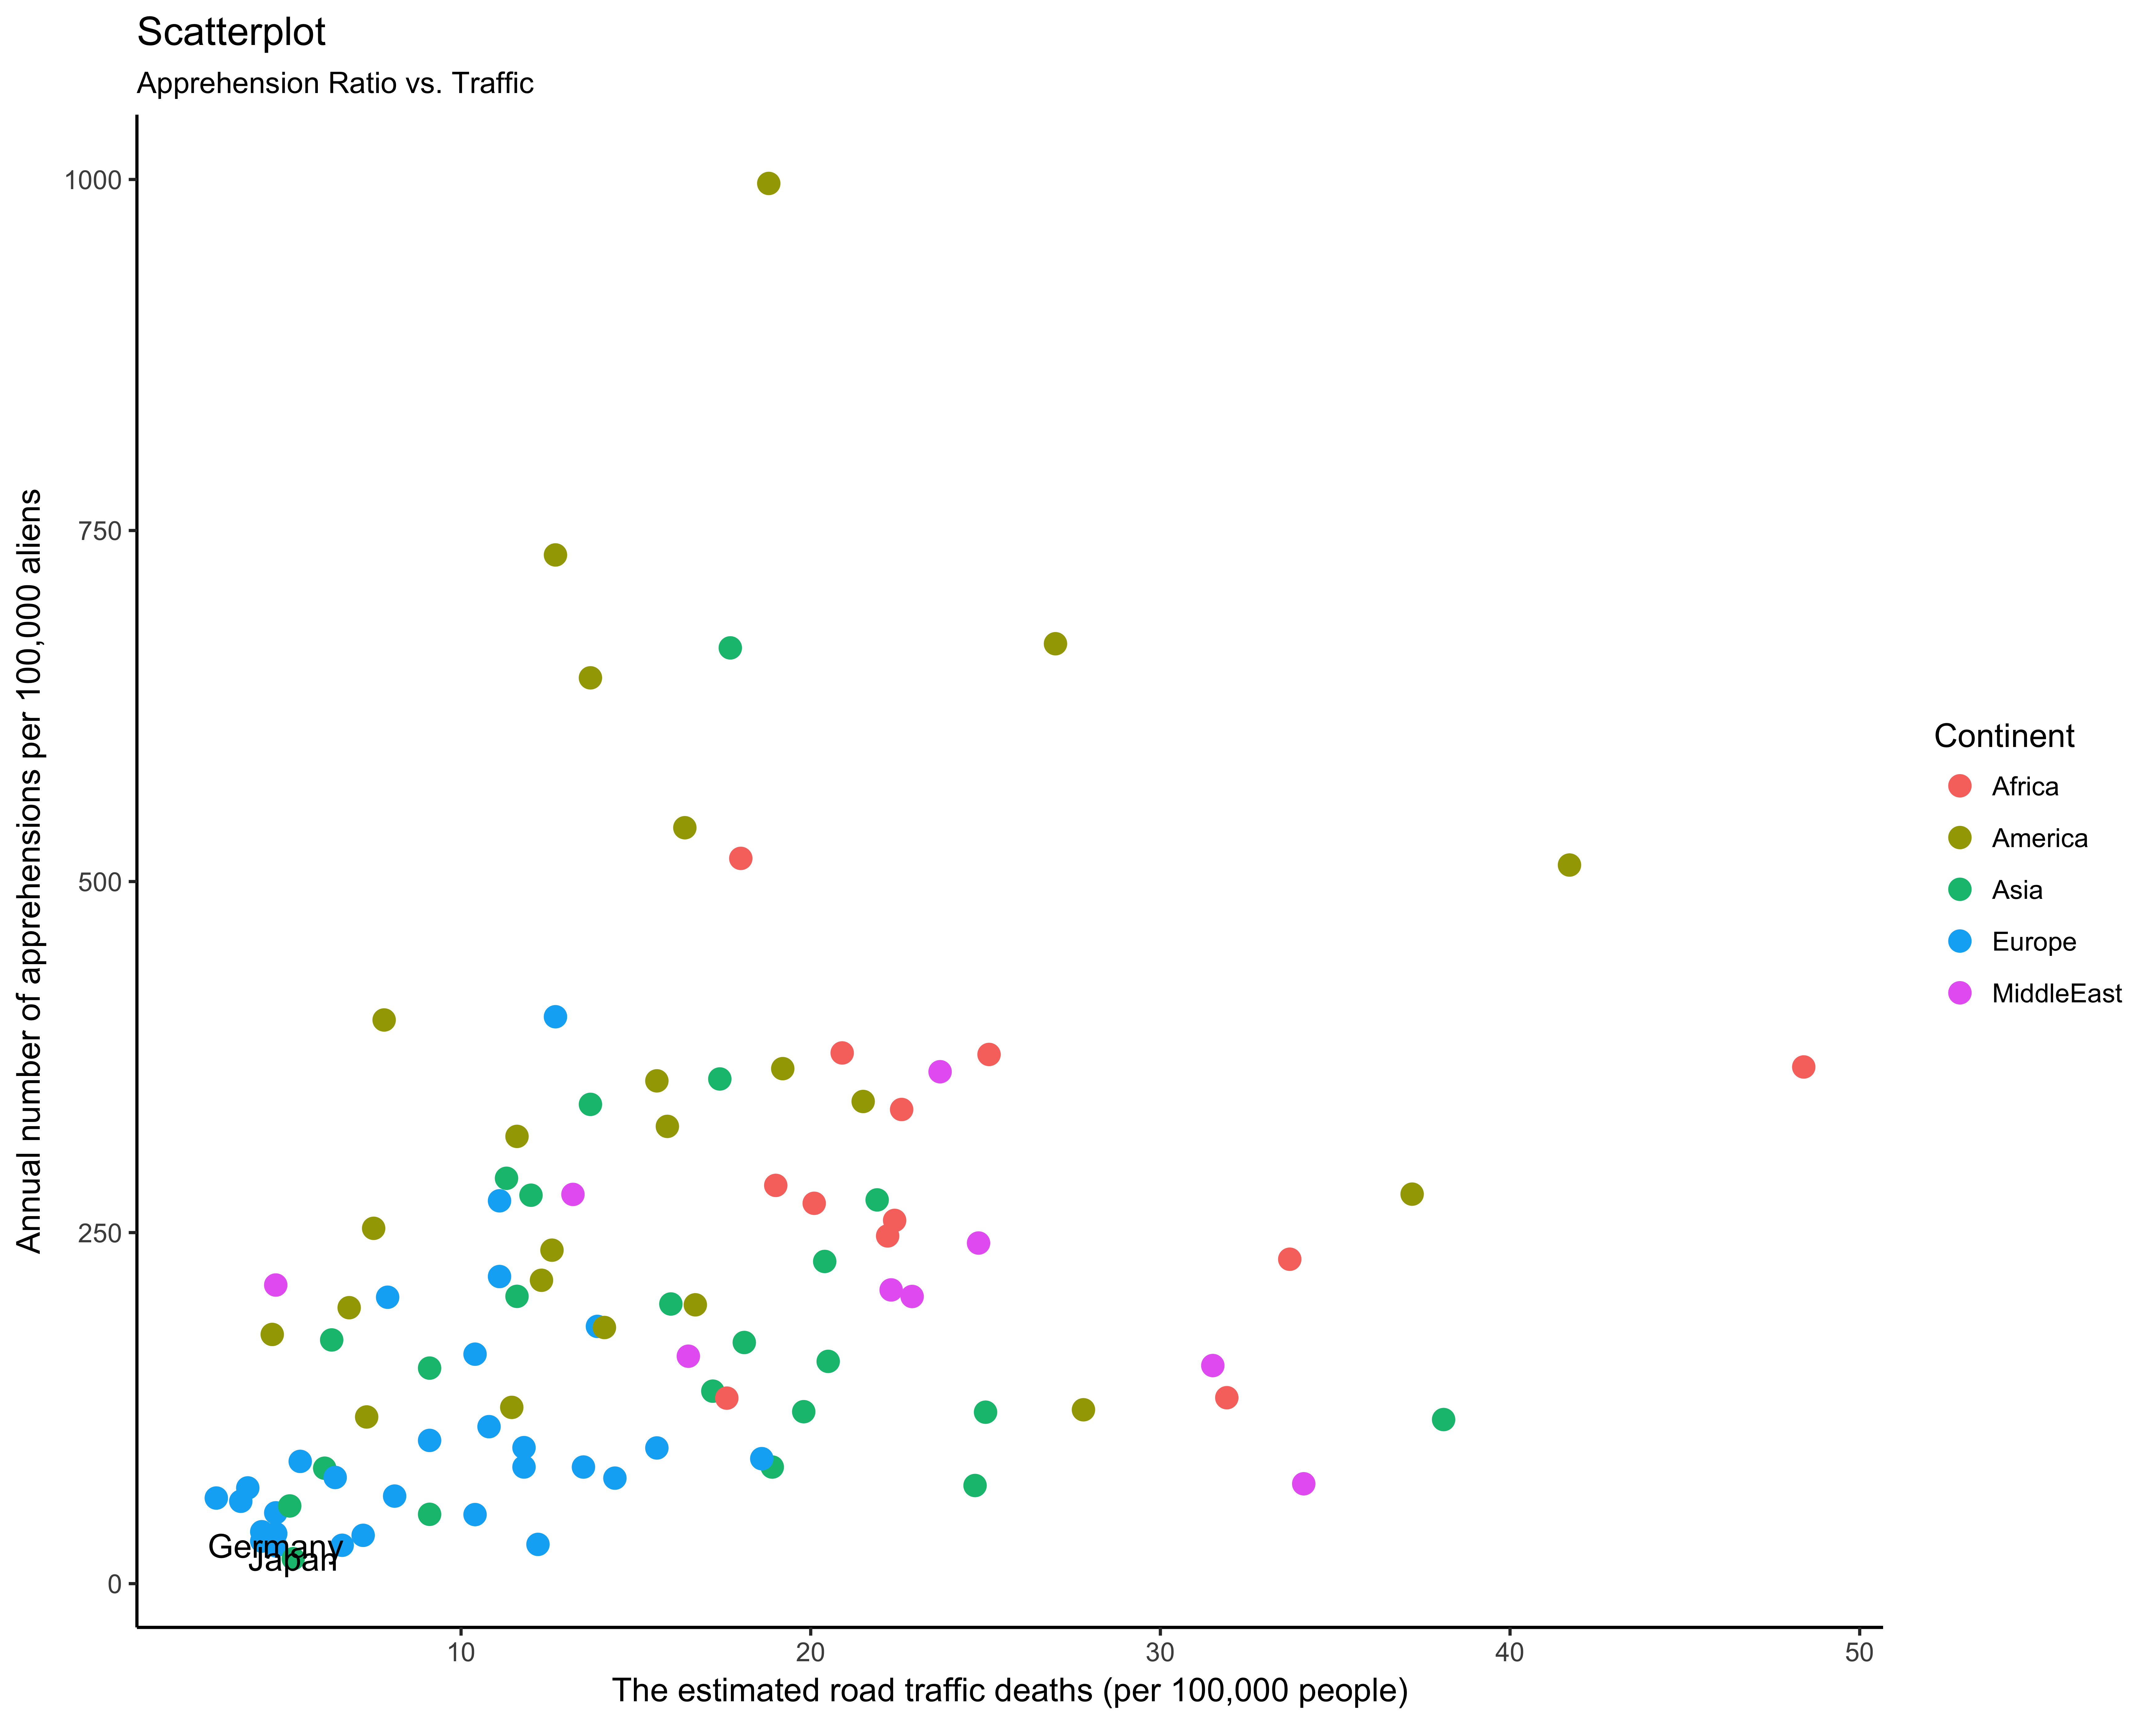
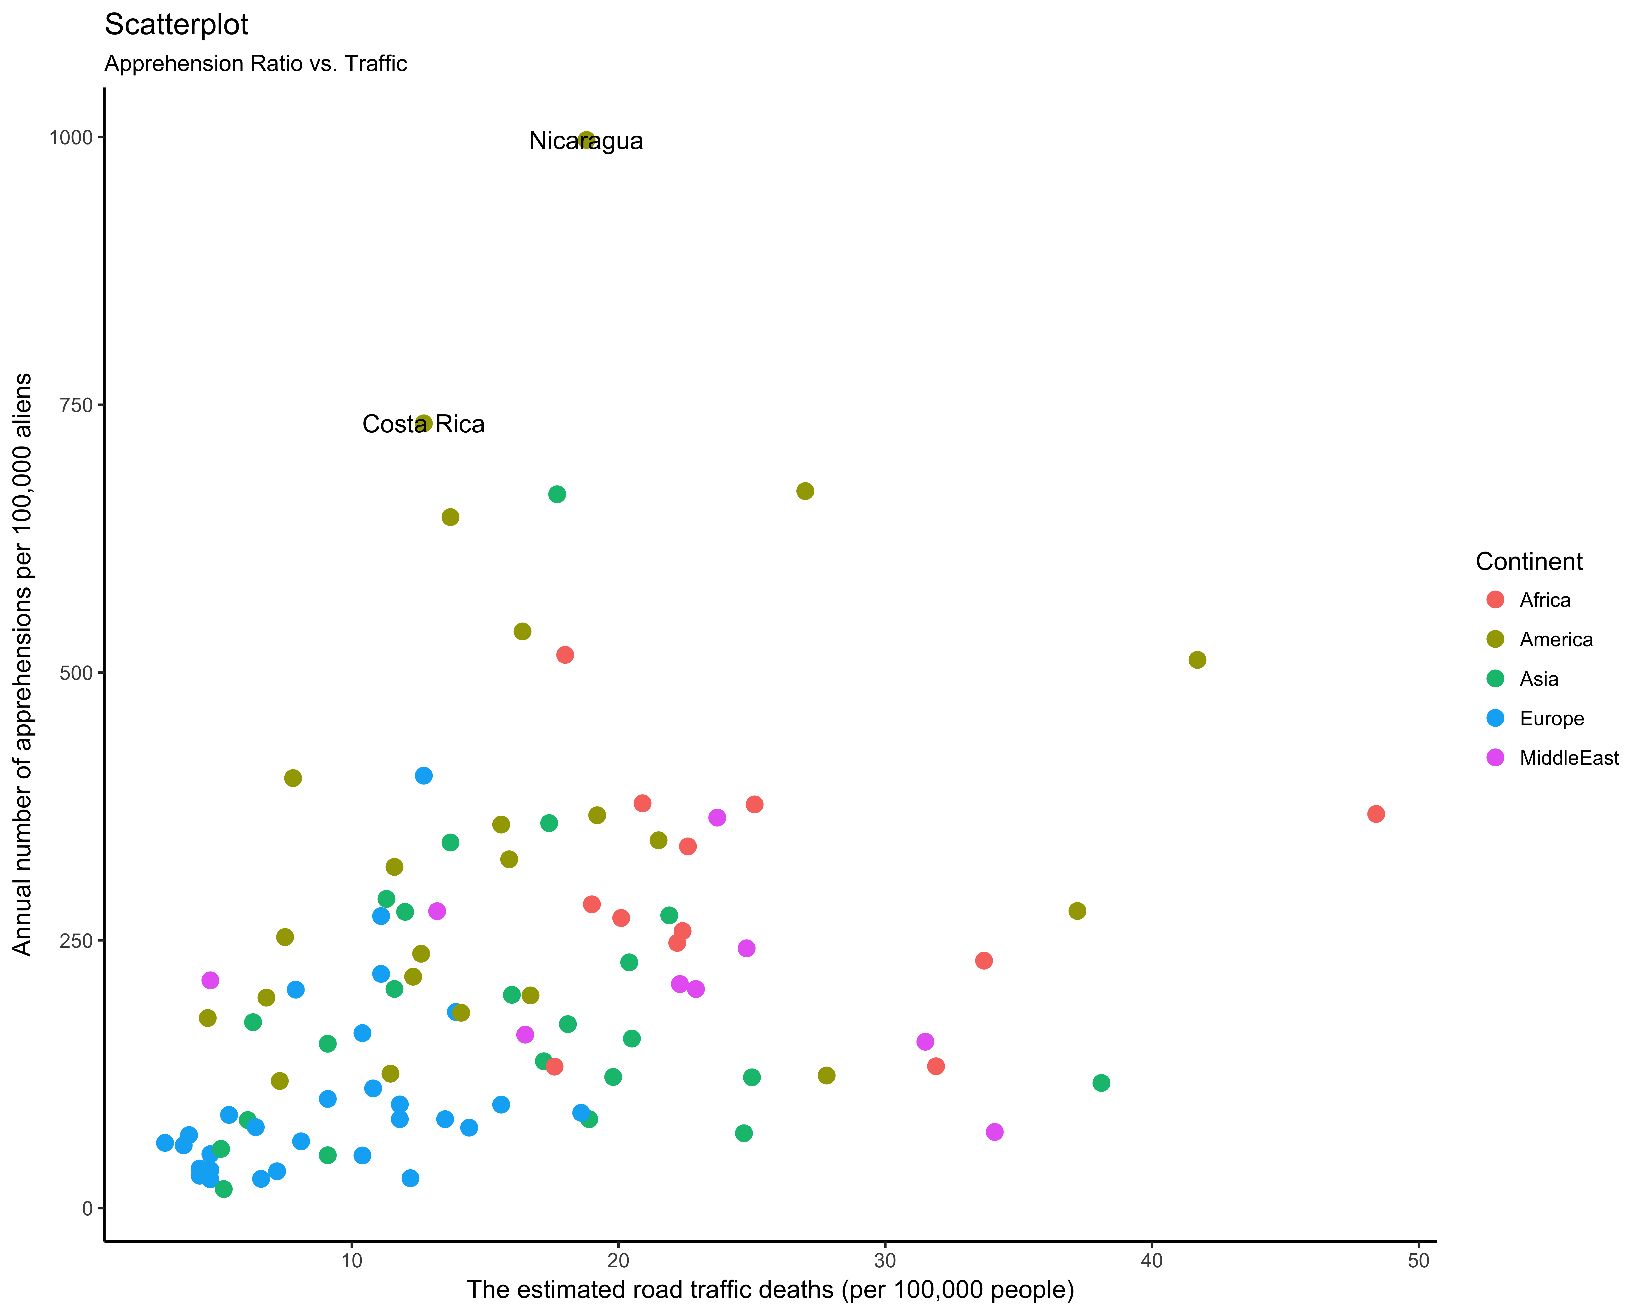
Annual number of apprehensions per 100,000 aliens VS. The estimated road traffic deaths (per 100,000 people)

Slide 18
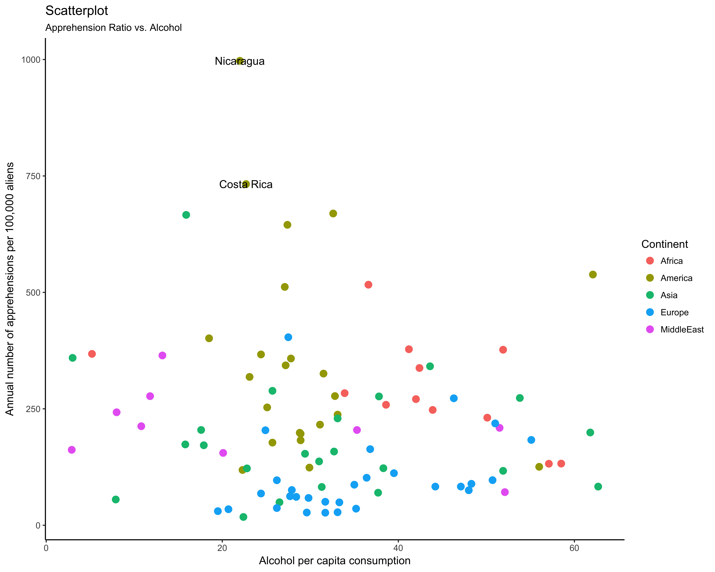
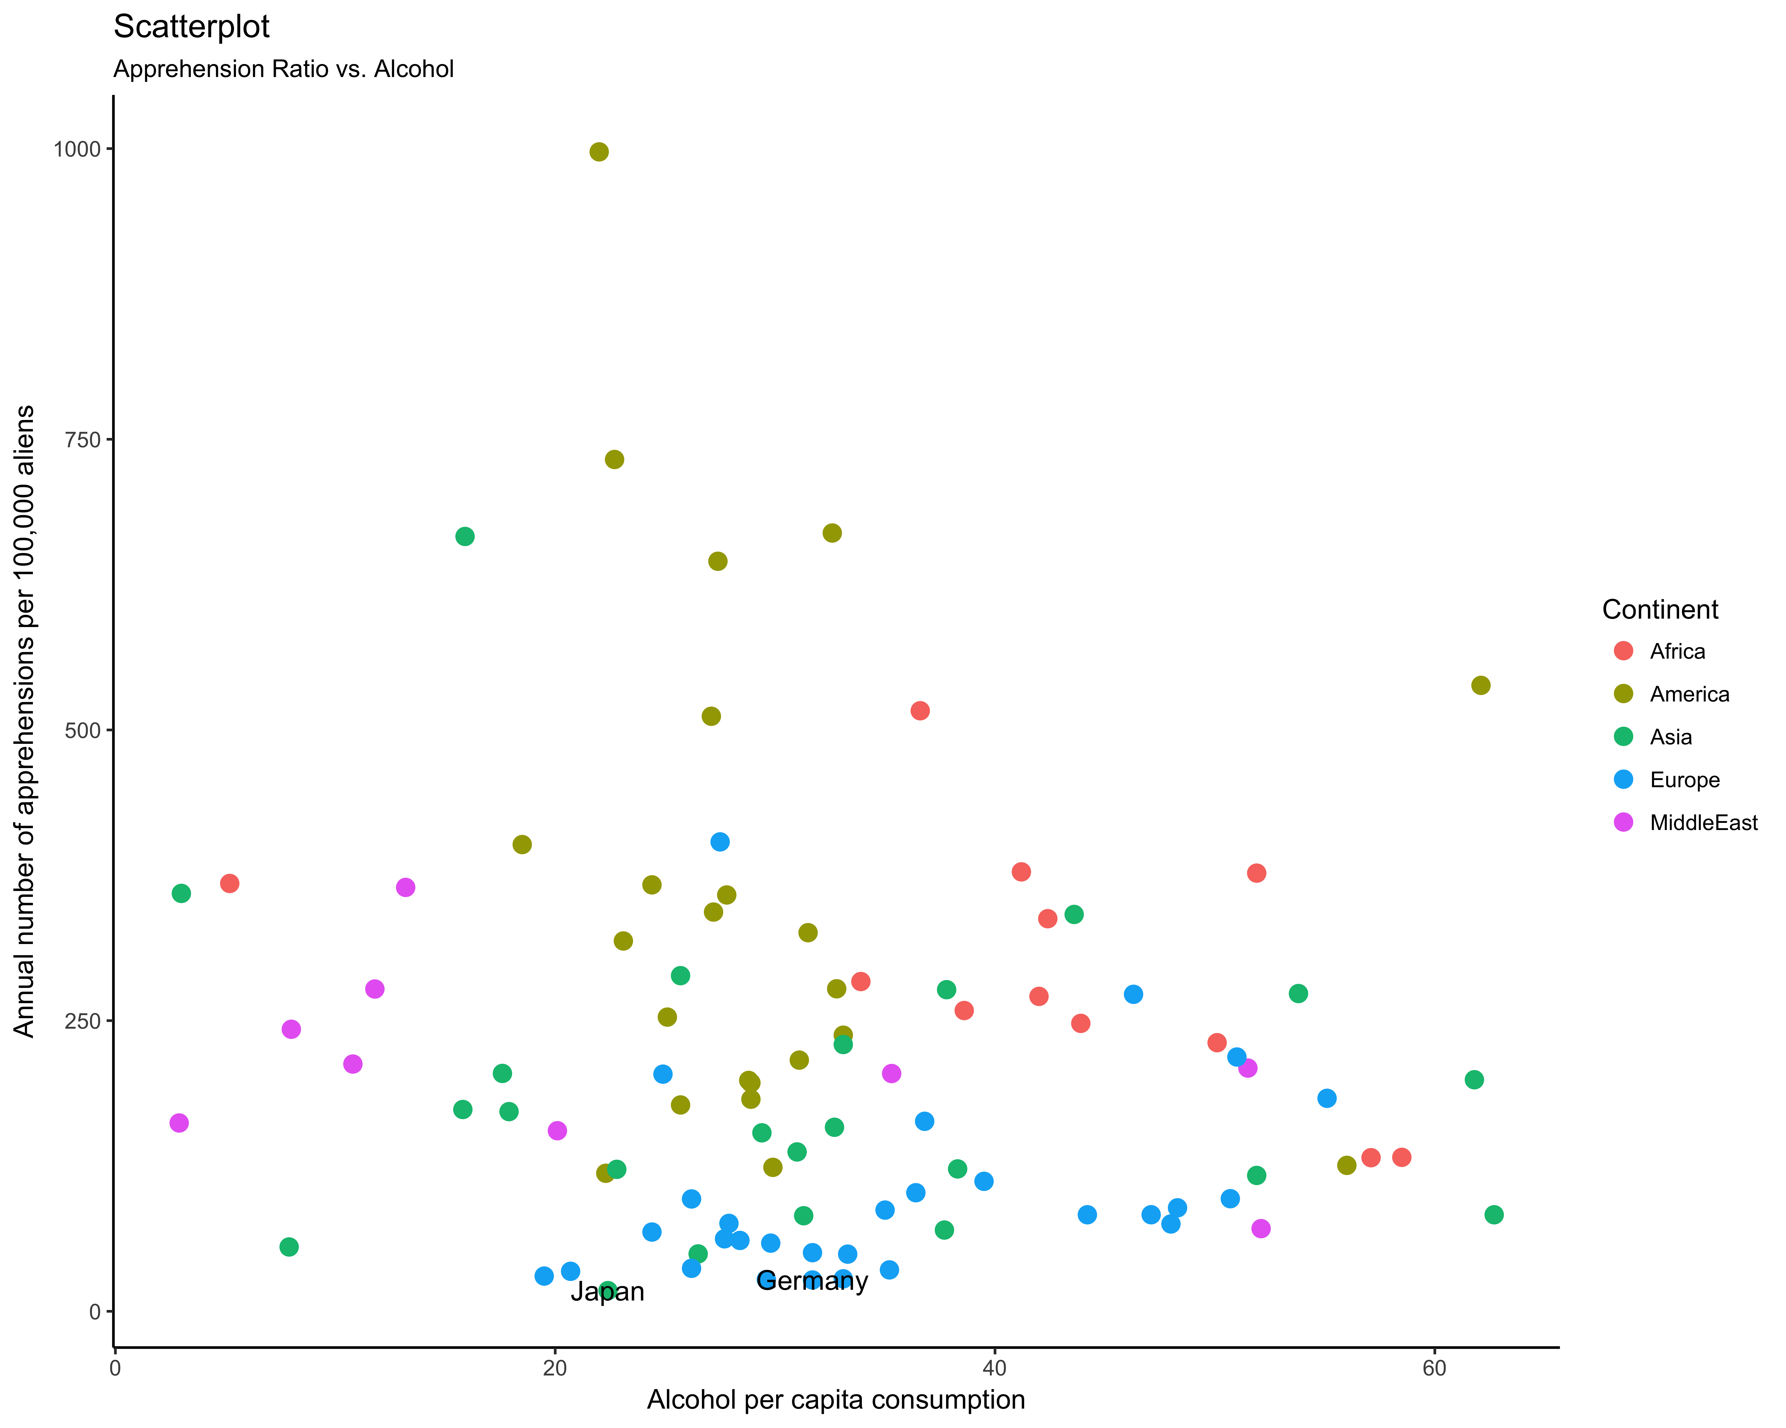
Annual number of apprehensions per 100,000 aliens VS. Alcohol per capita consumption (average daily intake; grams of pure alcohol; 15+ years population)

Slide 19
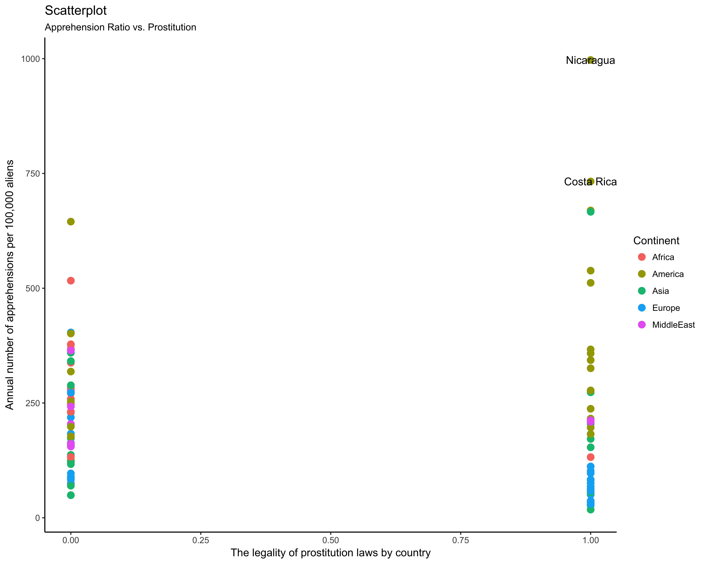
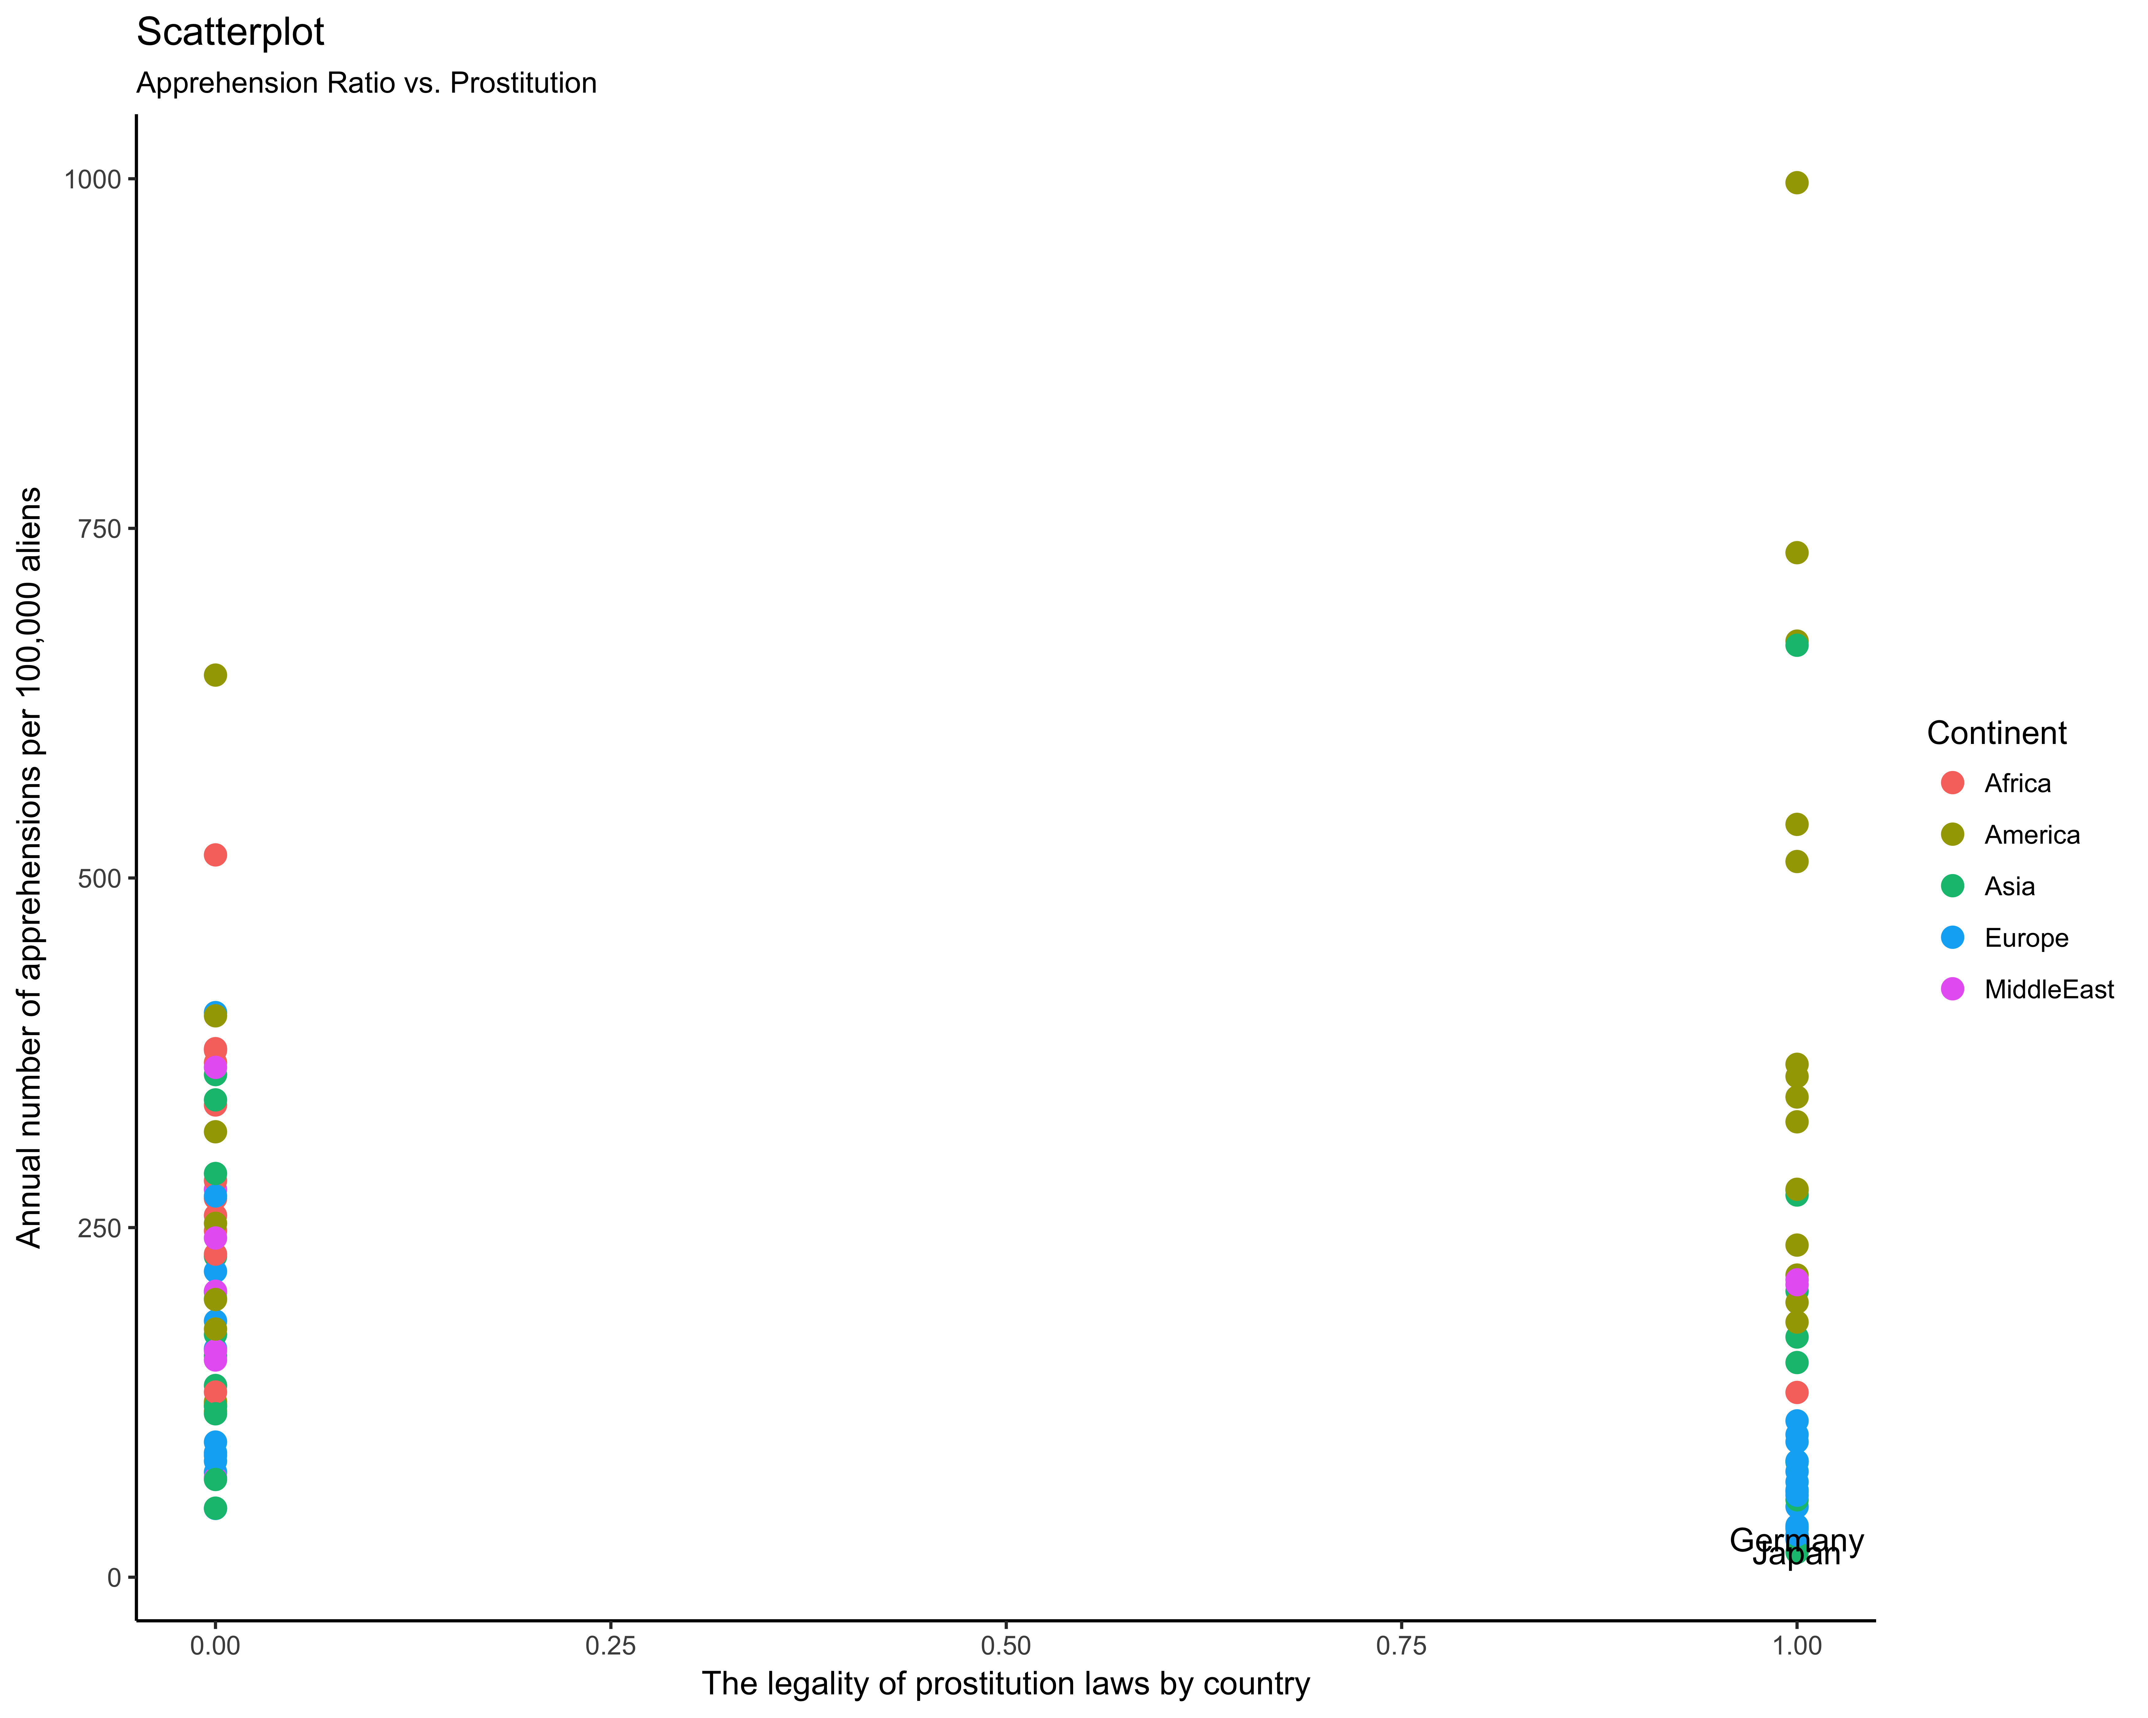
Annual number of apprehensions per 100,000 aliens VS. The legality of prostitution laws by country
0 (the prostitution is illegal) and 1 (otherwise)

Slide 20
SOURCES:
World Bank (2014) (World Development Indicators)
Prostitution.Procon.org (2010). 100 Countries and Their Prostitution Policies, 2010, ProCon.org, Online, viewed 30th March, 2010
WHO (2014b). “Global Status Report on Alcohol and Health,” World Health Organization
Barro R. & Lee, J. (2014). "A new Data Set of Educational Attainment in the World" v. 2.0, 06/2014
U.S. Department of Homeland Security (DHS)
U.S. Bureau of Economic Analysis (2014). “U.S. Direct Investment Abroad, U.S. Direct Investment Position Abroad on a Historical-Cost Basis,” Jan 23 2014
Kaufmann, D., Kraay, A. and Mastruzzi, M. (2014). “The Worldwide Governance Indicators,” The World Bank Group
ChartsBin (2010). ChartsBin statistics collector team 2010, The Legal Status of Prostitution by Country, ChartsBin.com, viewed 1st June, 2015
Migration Policy Institute (MPI) of the United States. Online source: http://www.migrationpolicy.org/programs/data-hub
ILO (2014). “Key Indicators of the Labor Market,” International Labor Organization, 2014
DistanceFromTo (2015). Distance Between Cities&Places
Bilol Buzurukov and Byeong Wan Lee (2015). Determinants of Immigrant Apprehensions: The Case of U.S. Immigration. Economics: The Open-Access, Open-Assessment E-Journal, 9 (2015-39): 1—25. http://dx.doi.org/10.5018/economics-ejournal.ja.2015-39
UNODC (2014a). “International Homicide Statistics,” United Nations Office on Drugs and Crime, 2014
WHO (2014a). “Road Traffic Death Data by Country,” World Health Organization

